Slide 1

User Manual 2022

Slide 2
Contents
Language Changer 4
Introduction 5
Pinboard 7
Create your account 9
Confirm email 11
Create your Business Card 13
Login 14
Edit Profile – General Details 15
Edit Profile Details – Languages 20
Edit Profile Details – Free Text 25
Edit Profile – Website, Social Media 27
Edit Profile – BPW Infos 30
Edit Profile BPW Infos – BPW Offices 35
Edit Profile BPW Infos – City Map View 36
Edit Profile BPW Infos – Your Offers 38
Edit Profile Validation – Directory Mailings 40
Edit Profile Validation – President‘s Email 41
Activation of the Business Card 43
Find your Business Card 48
Edit your Business Card 56
Logged In 57
Settings 58
Contact 65

Slide 3
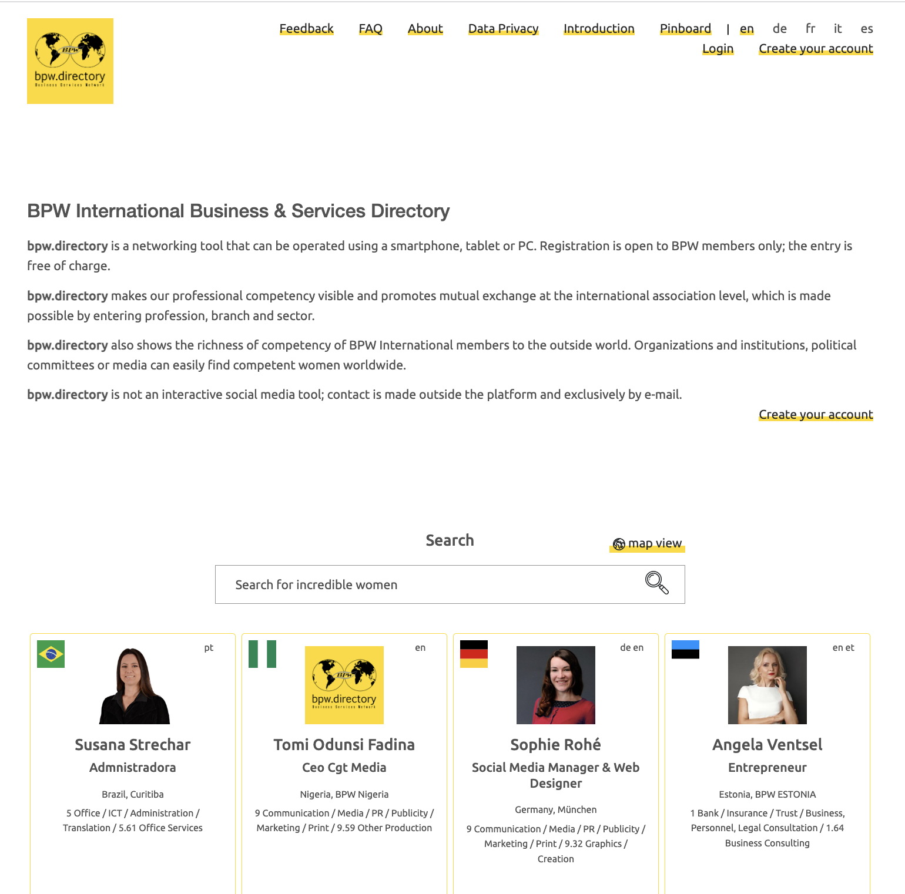
Welcome!
www.bpw.directory

Slide 4
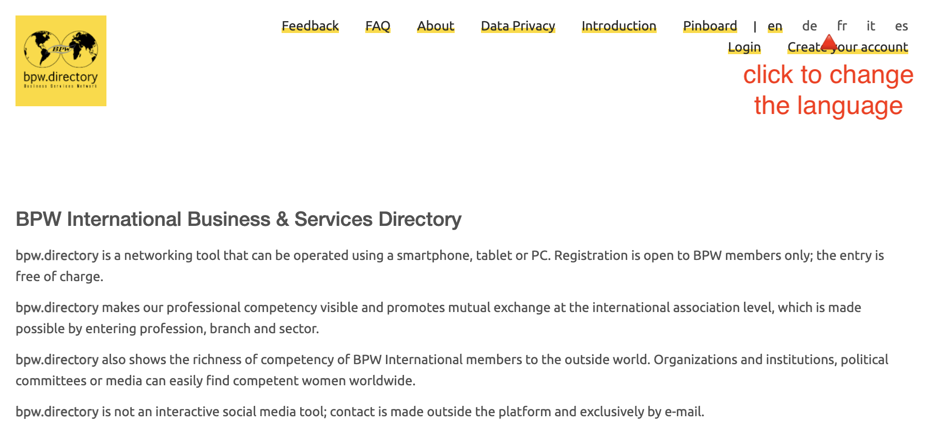
Language Changer

Slide 5
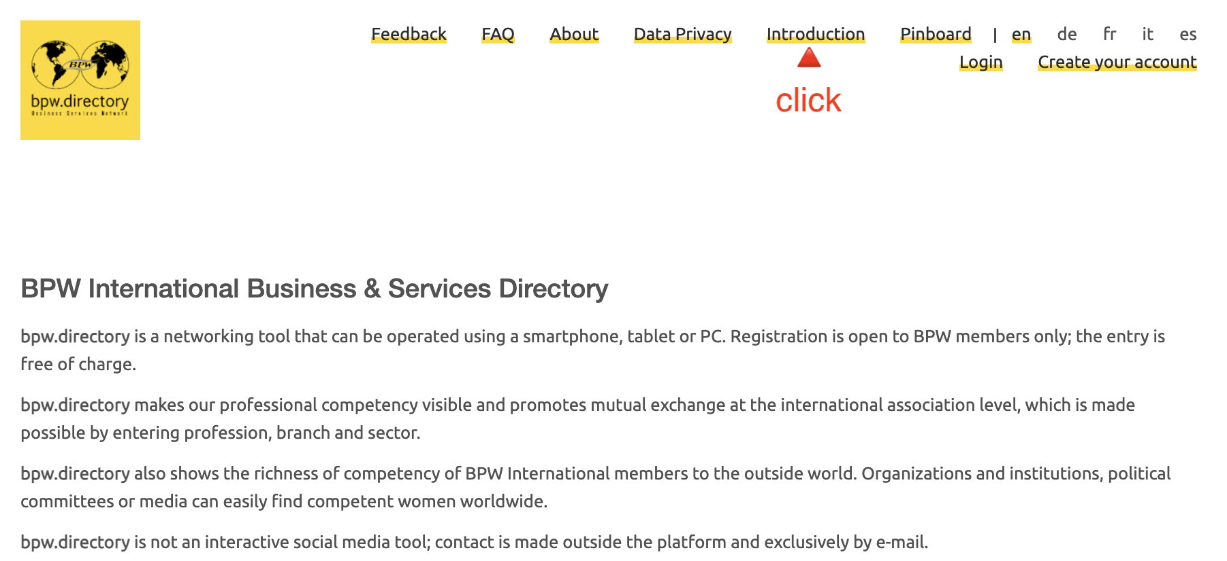
Navigation - Introduction

Slide 6
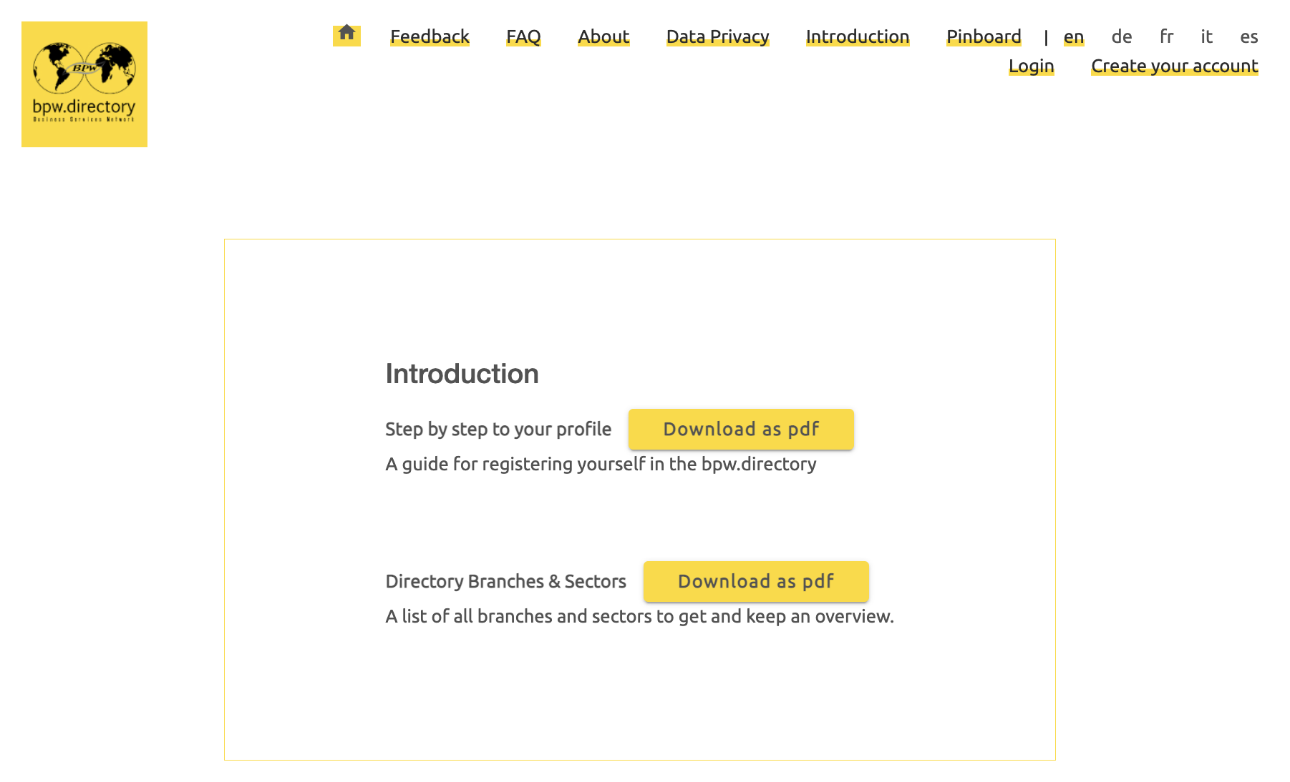
Navigation Introduction – Step by step, Branches & Sectors (pdf)

Slide 7
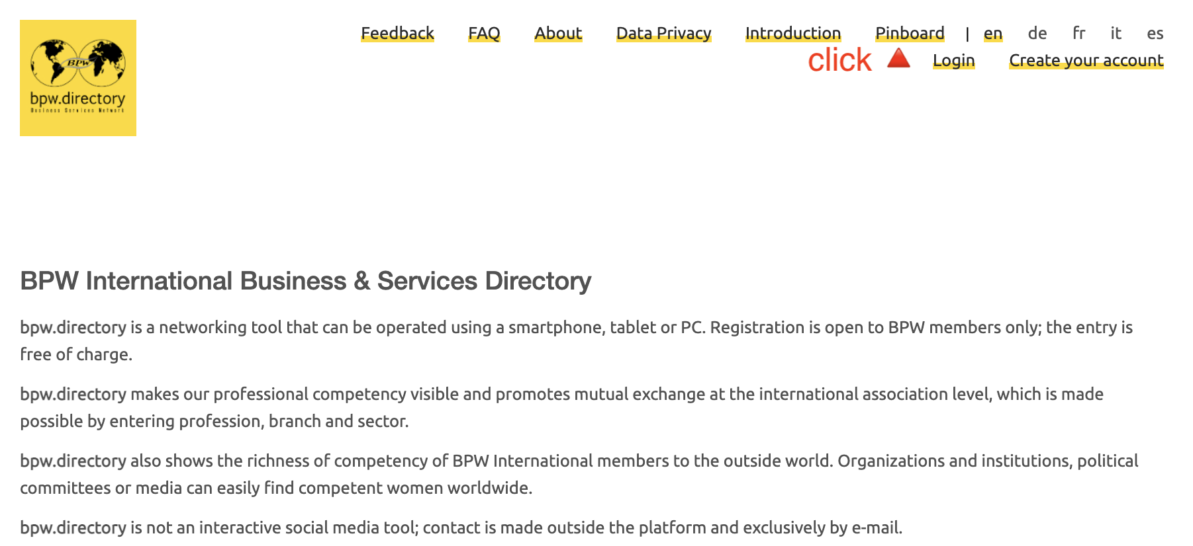
Navigation - Pinboard

Slide 8
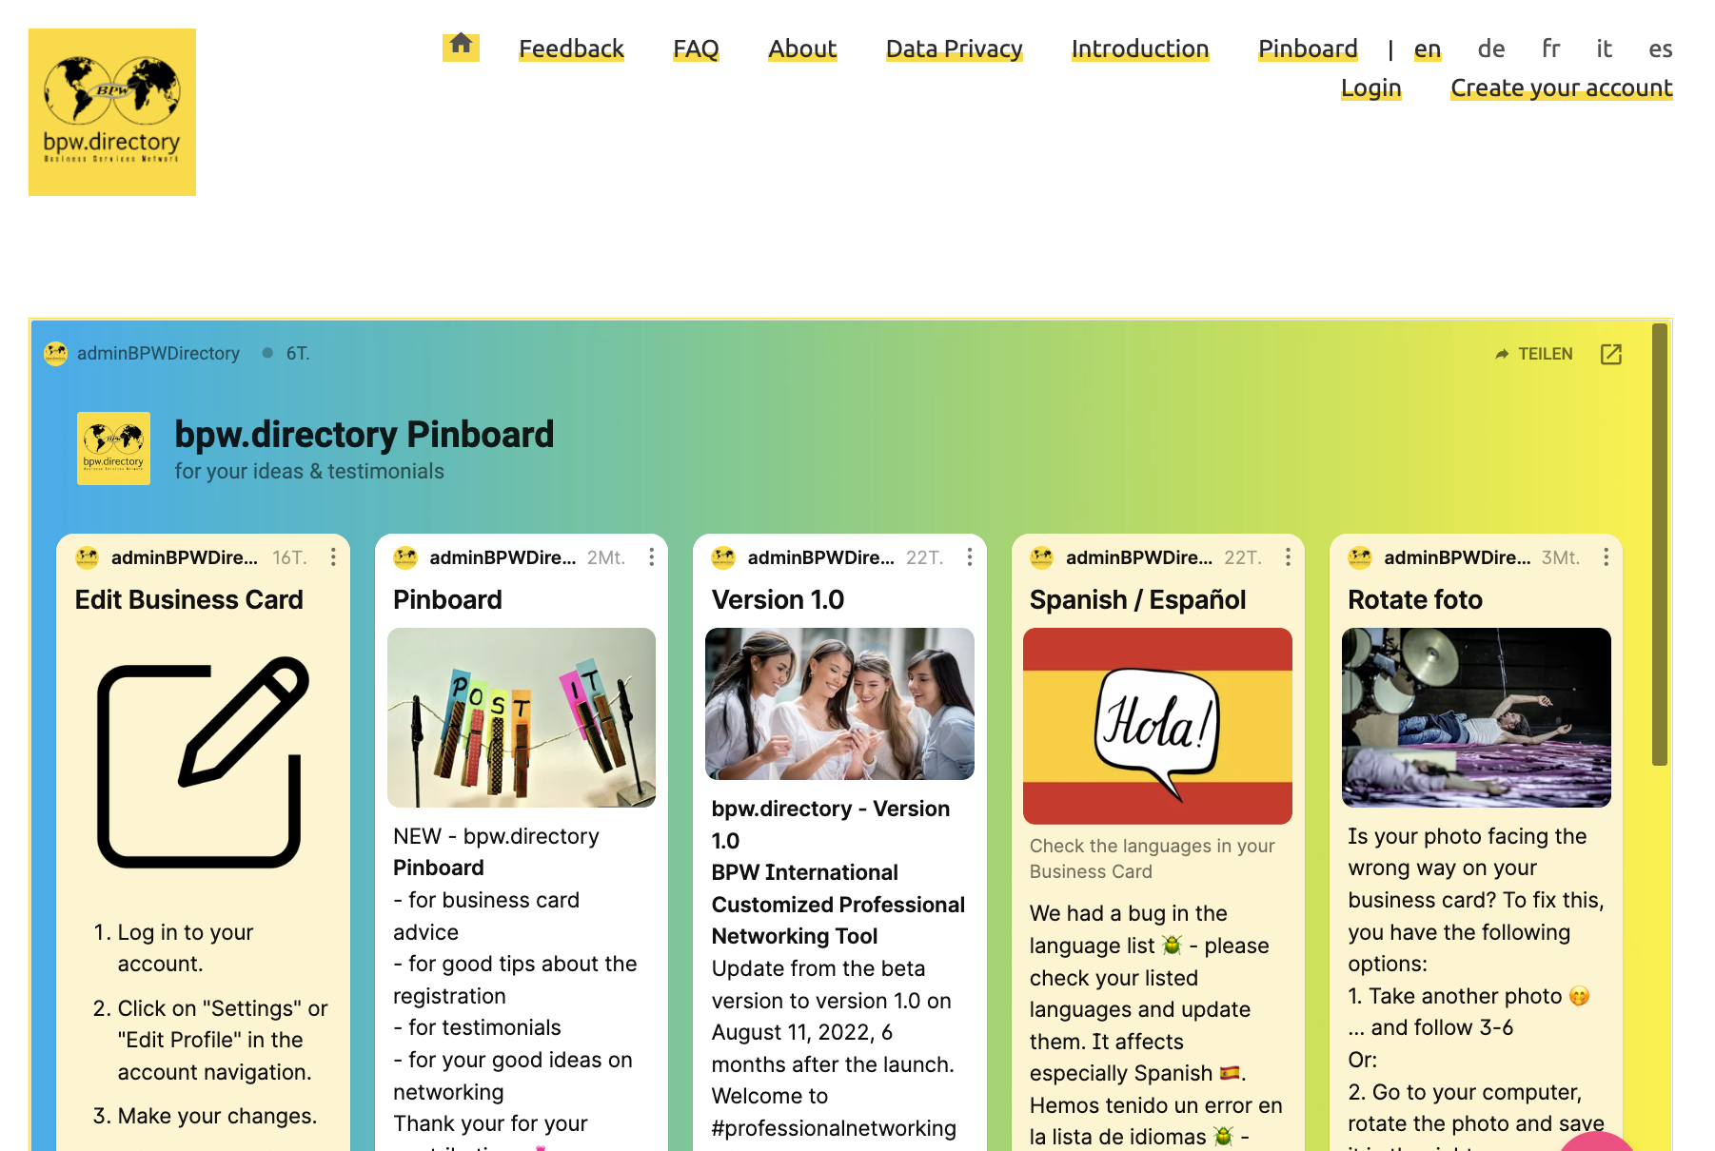
Pinboard

Slide 9
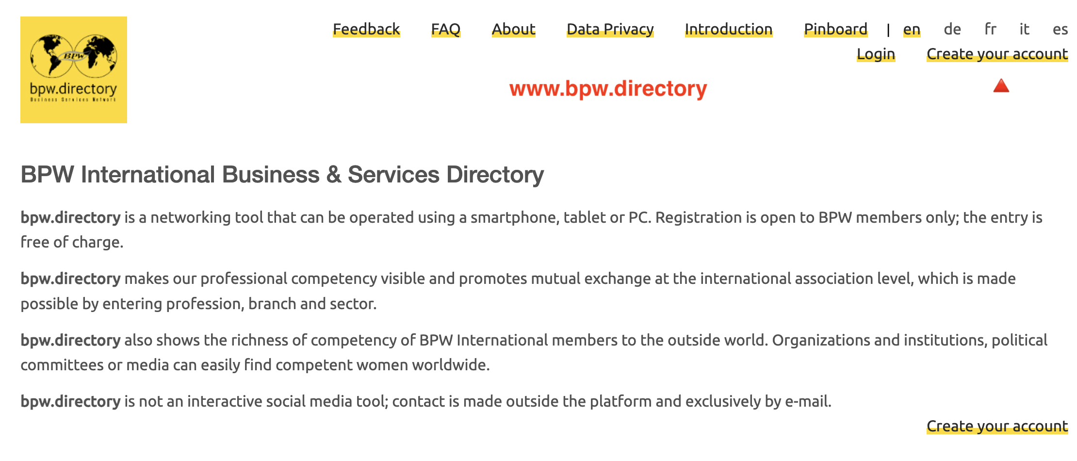
Create your account

Slide 10
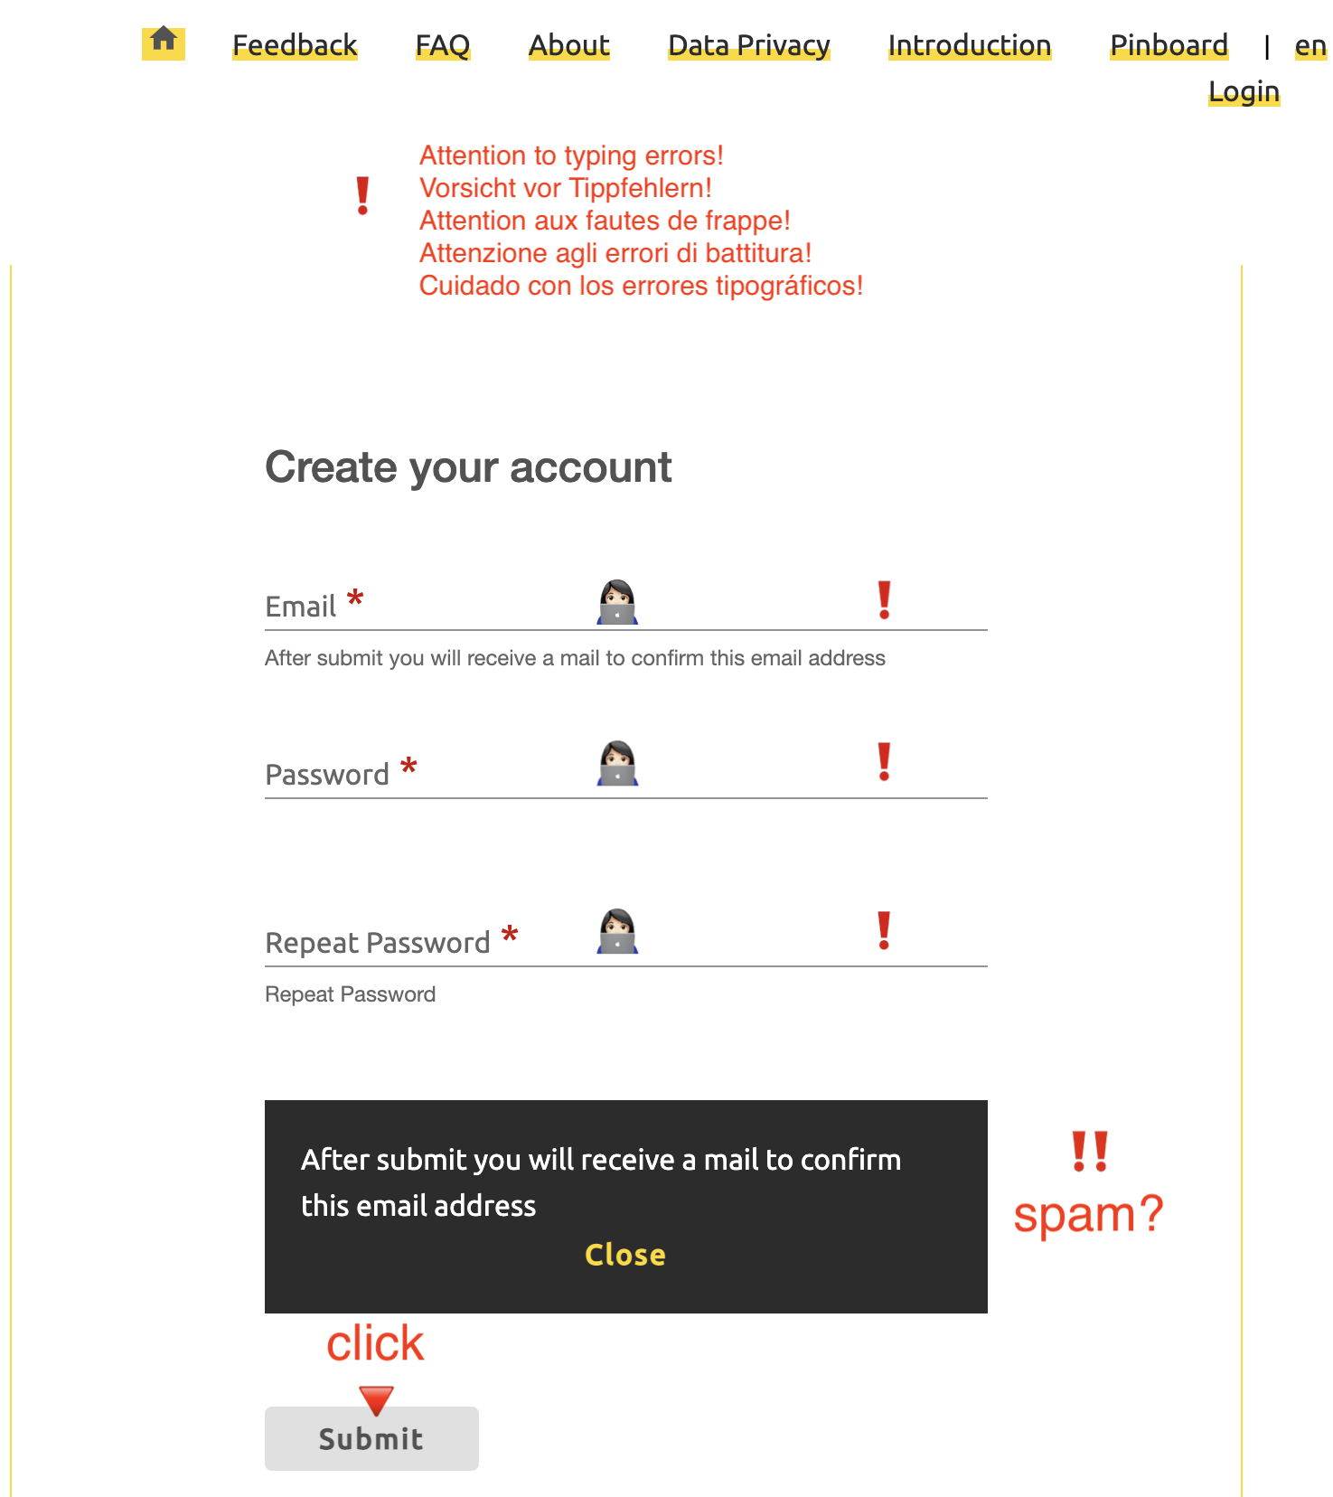
Watch out for typos!

Slide 11
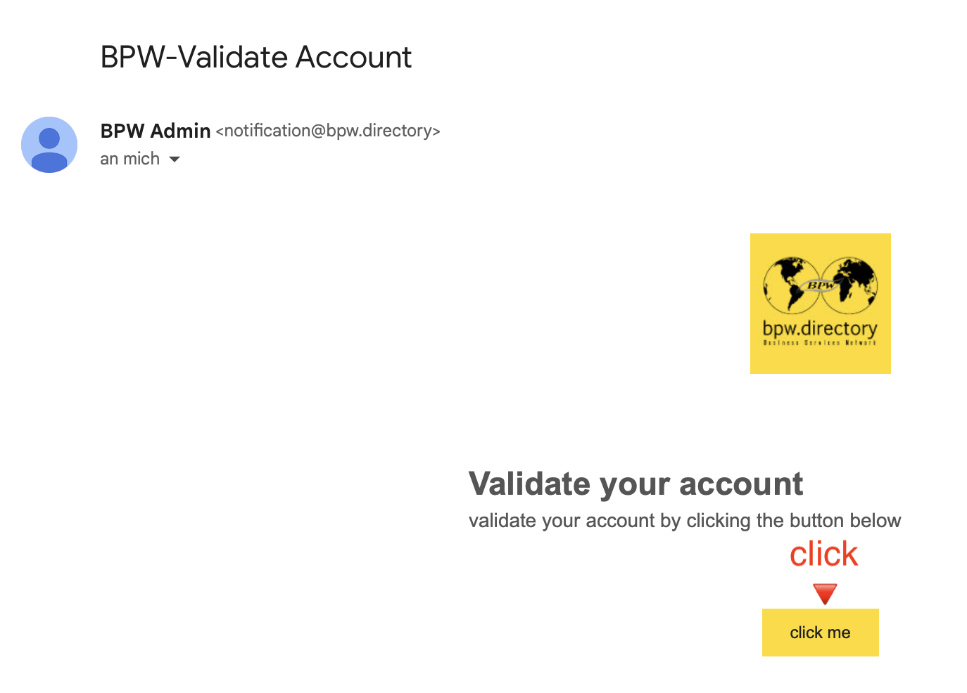
Check your emails – and your spam!

Slide 12
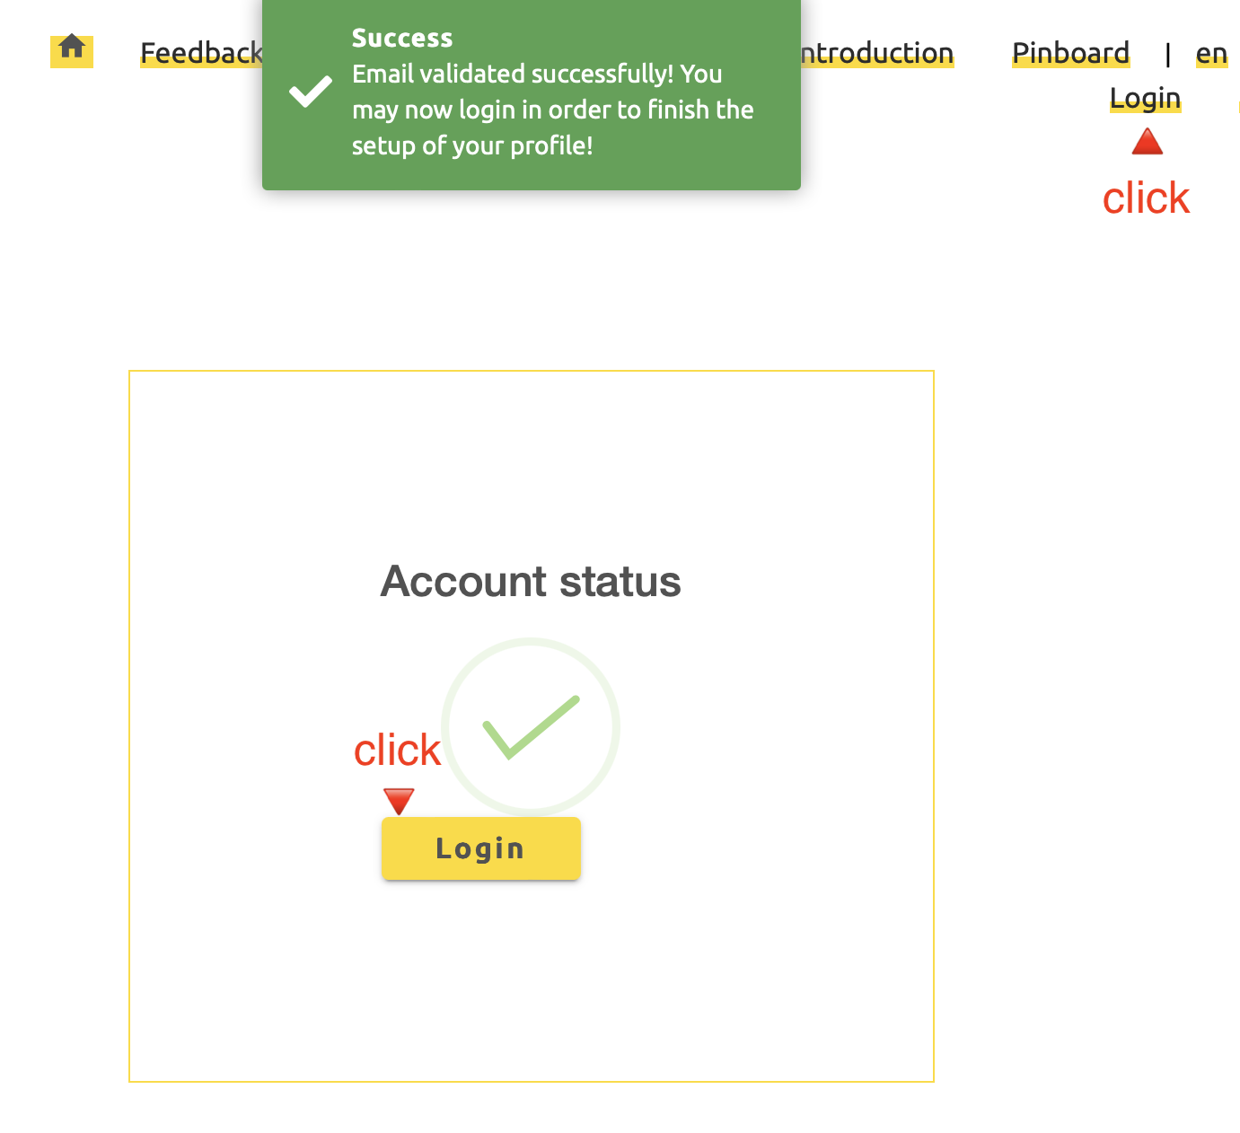
Email validated successfully

Slide 13
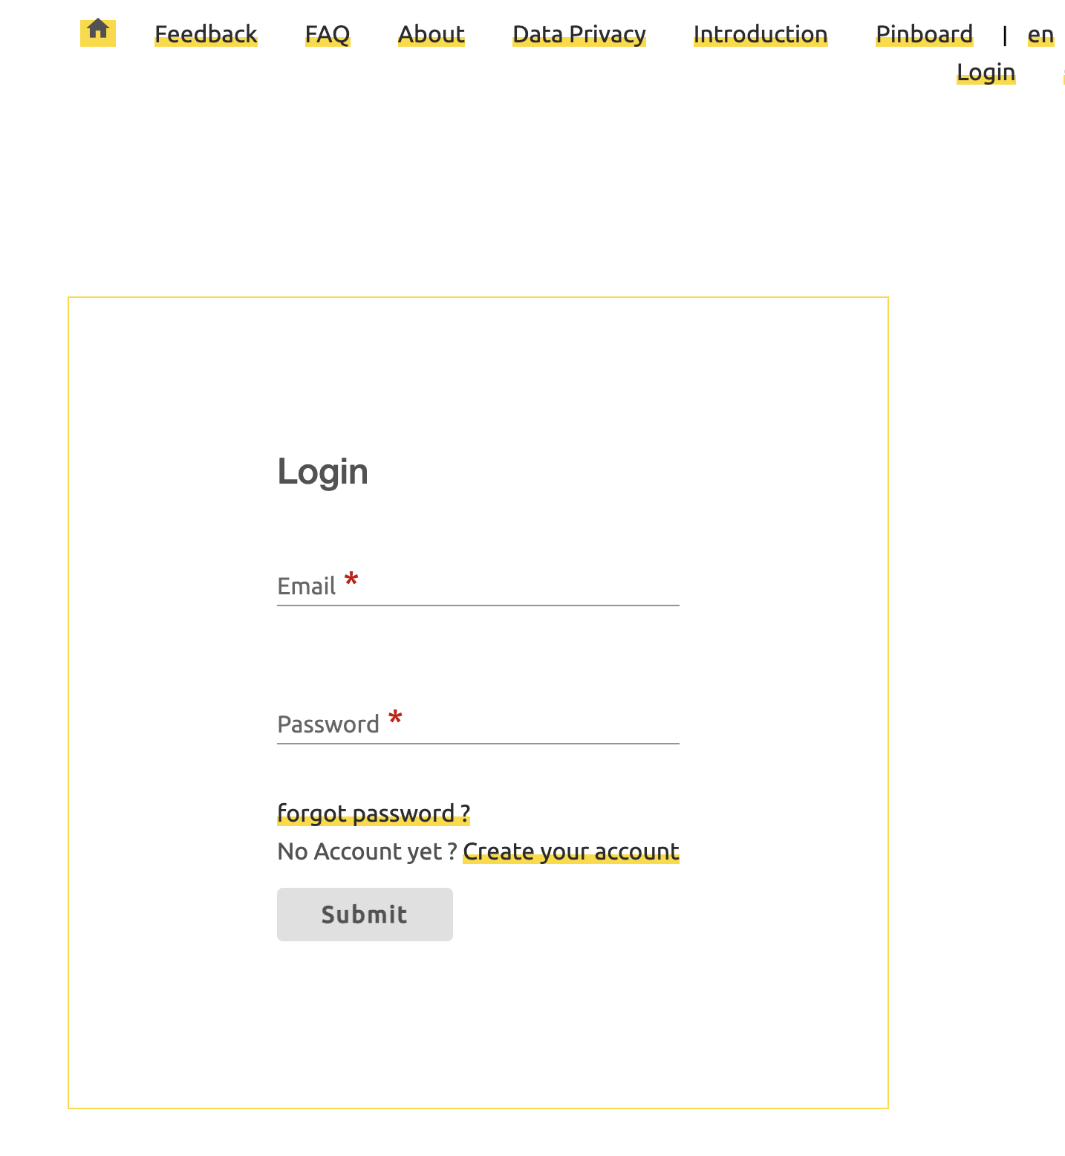
Create your Business Card

Slide 14
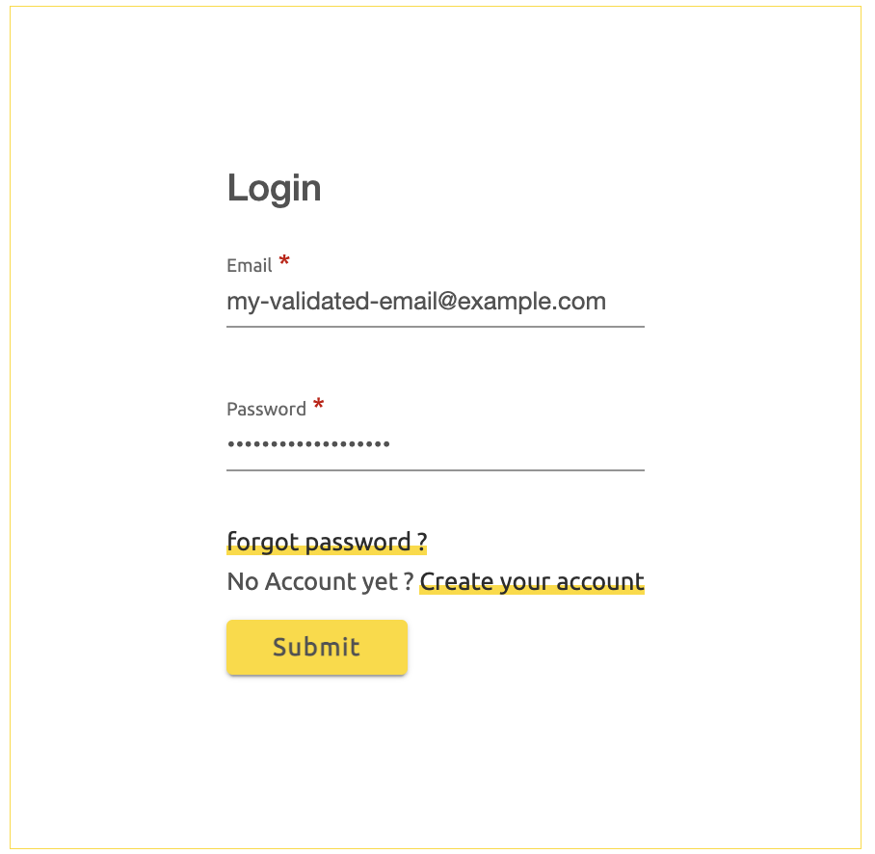
Login

Slide 15
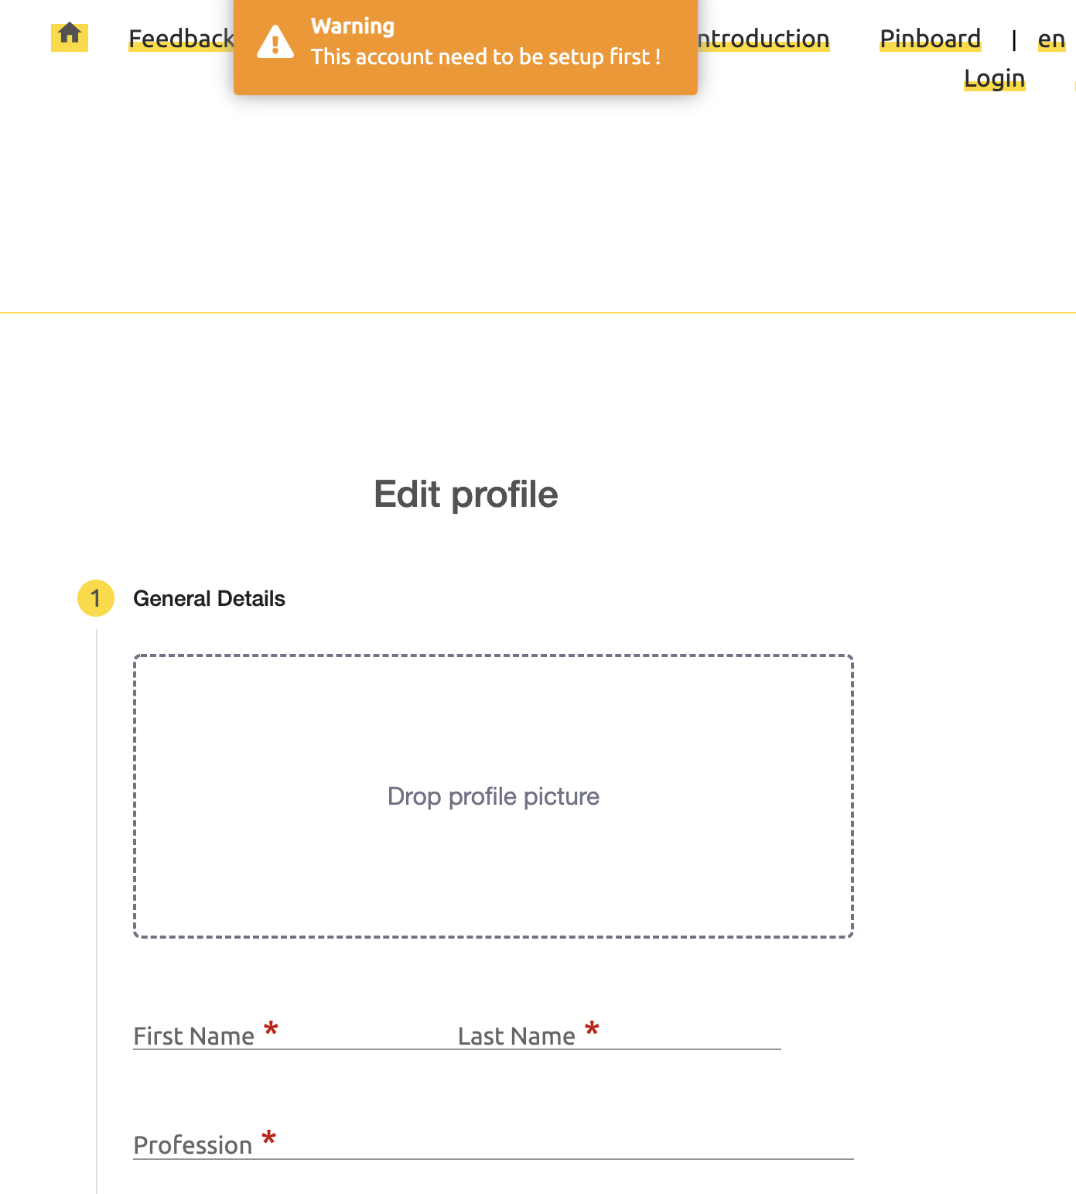
Edit Profile General Details

Slide 16
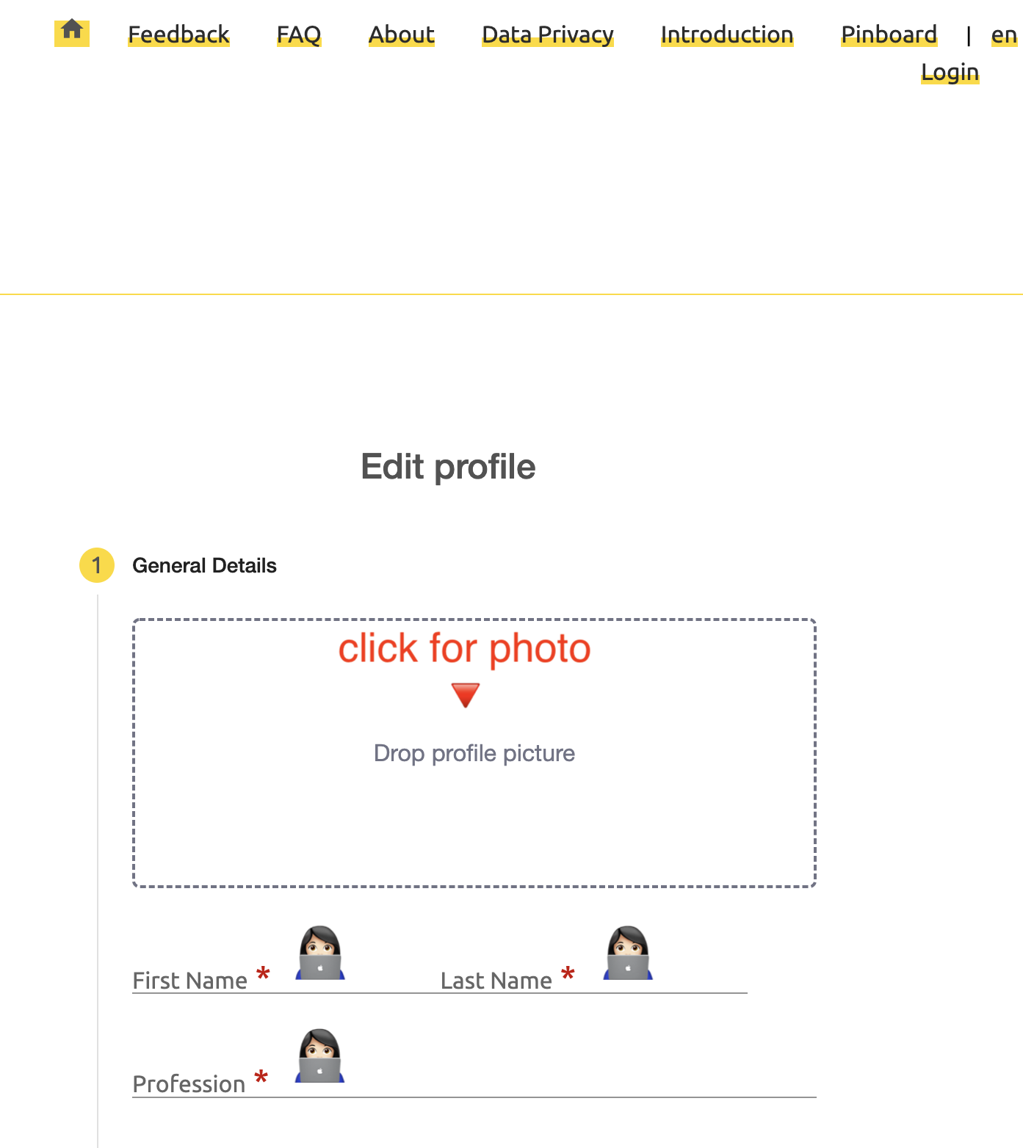
Edit Profile General Details – Photo, Name & Profession

Slide 17
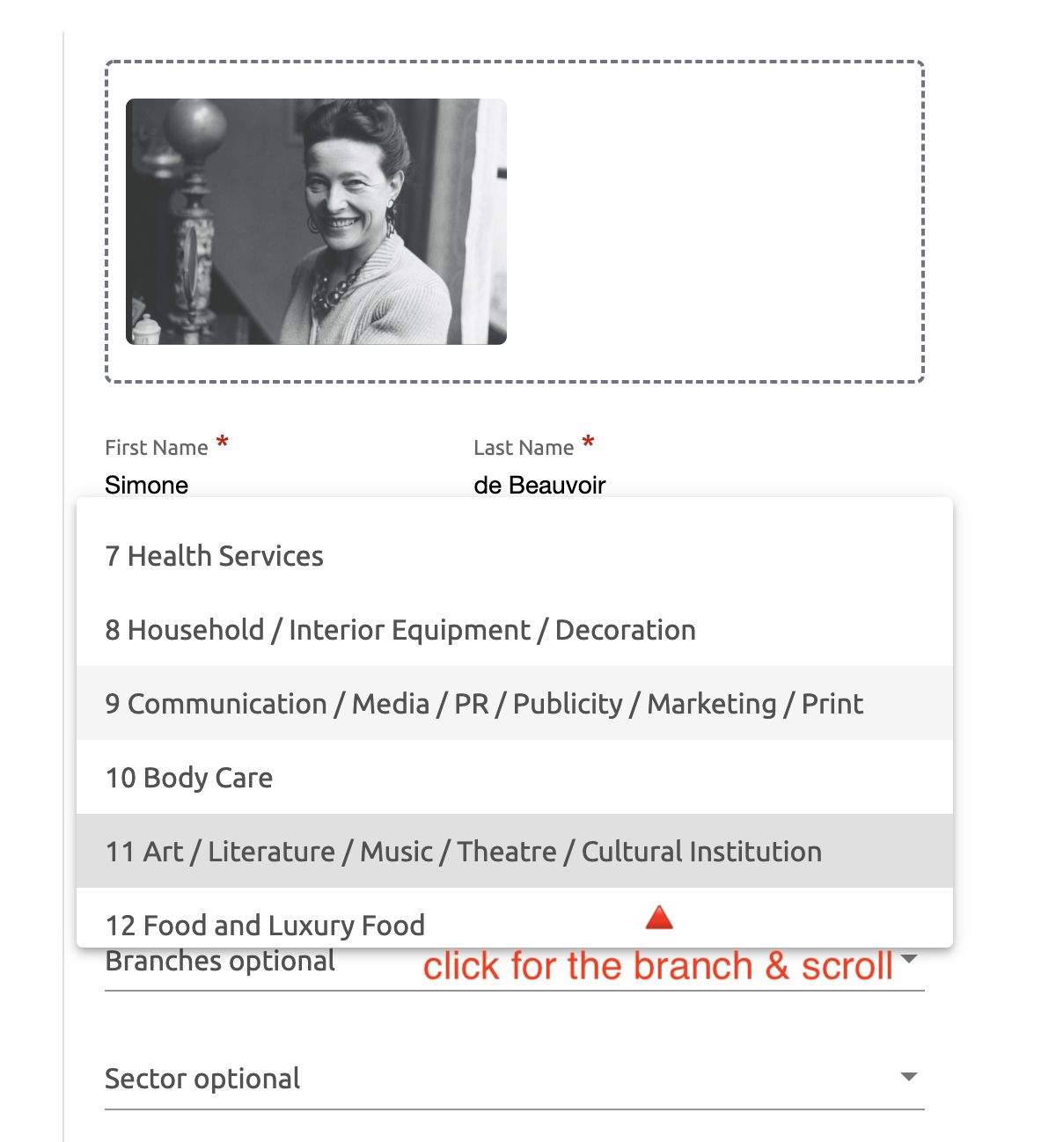
Edit Profile General Details – Branch & Sector

Slide 18
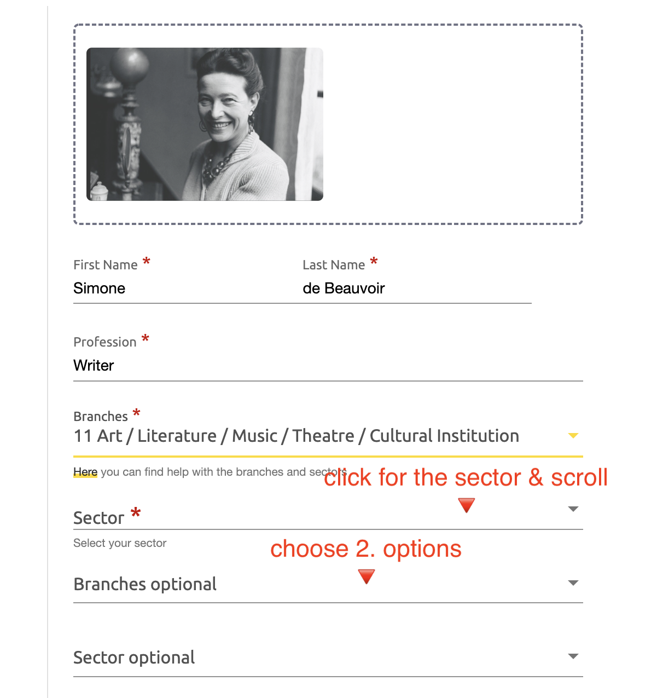
Edit Profile General Details – Branch & Sector

Slide 19
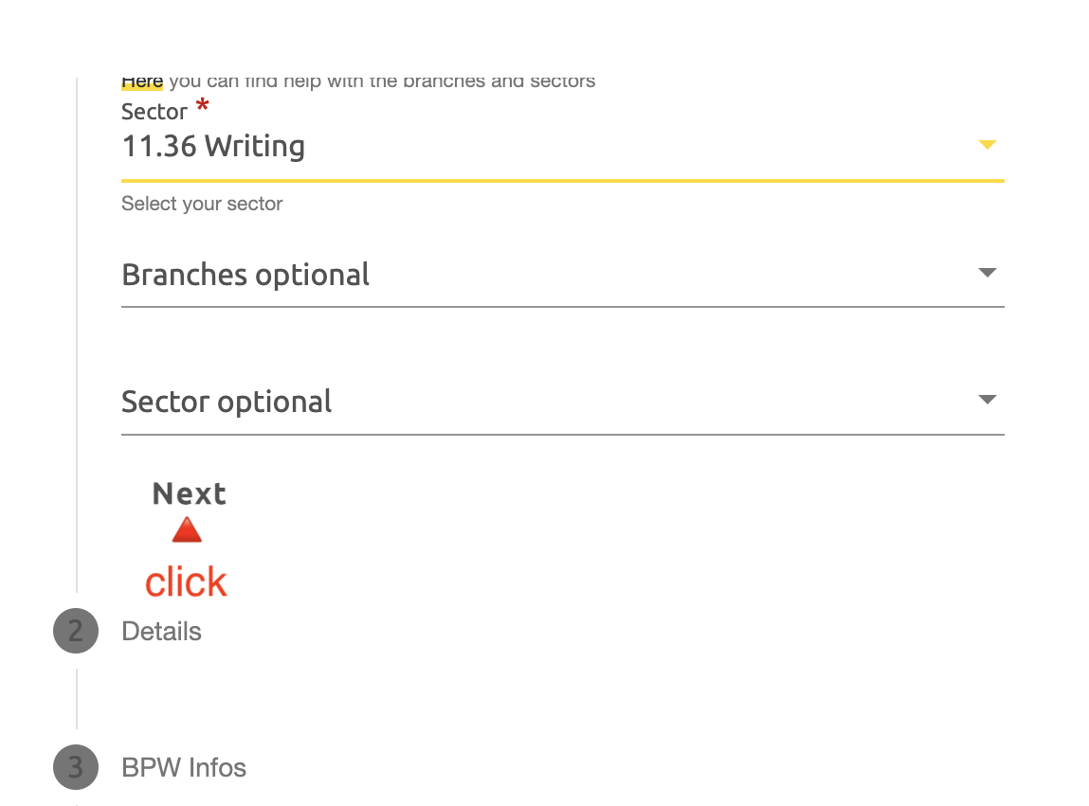

Slide 20
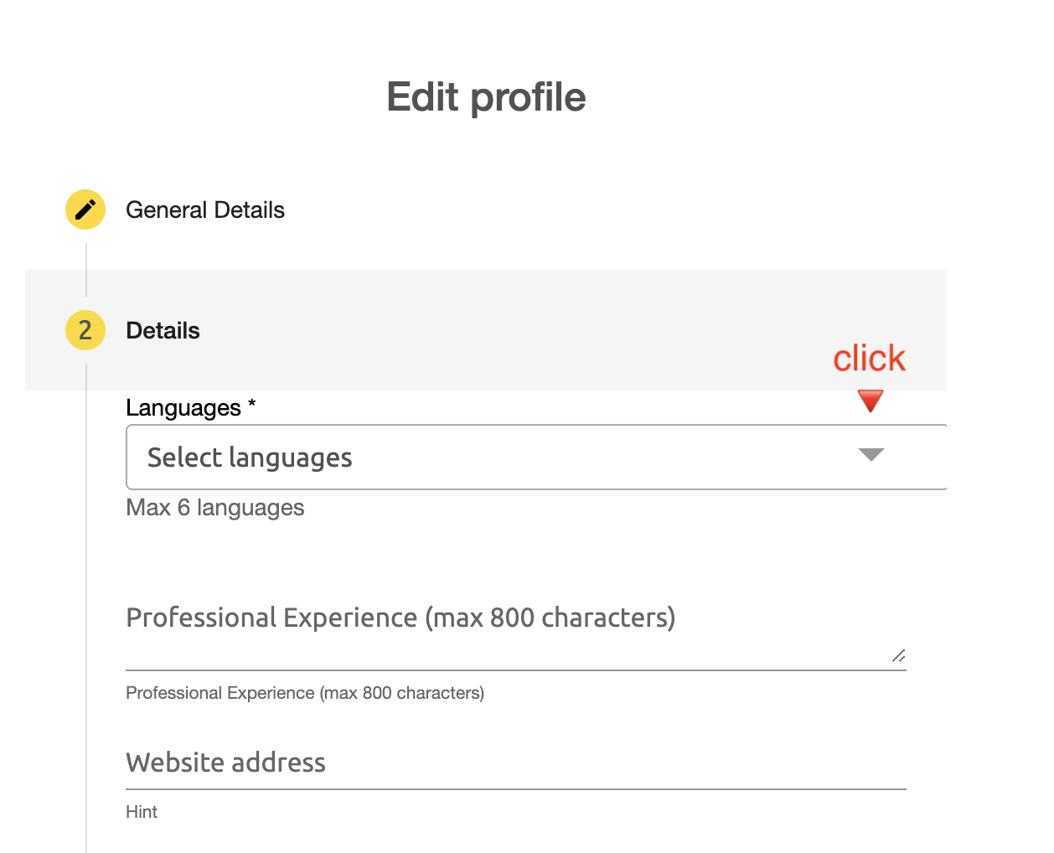
Edit Profile Details

Slide 21
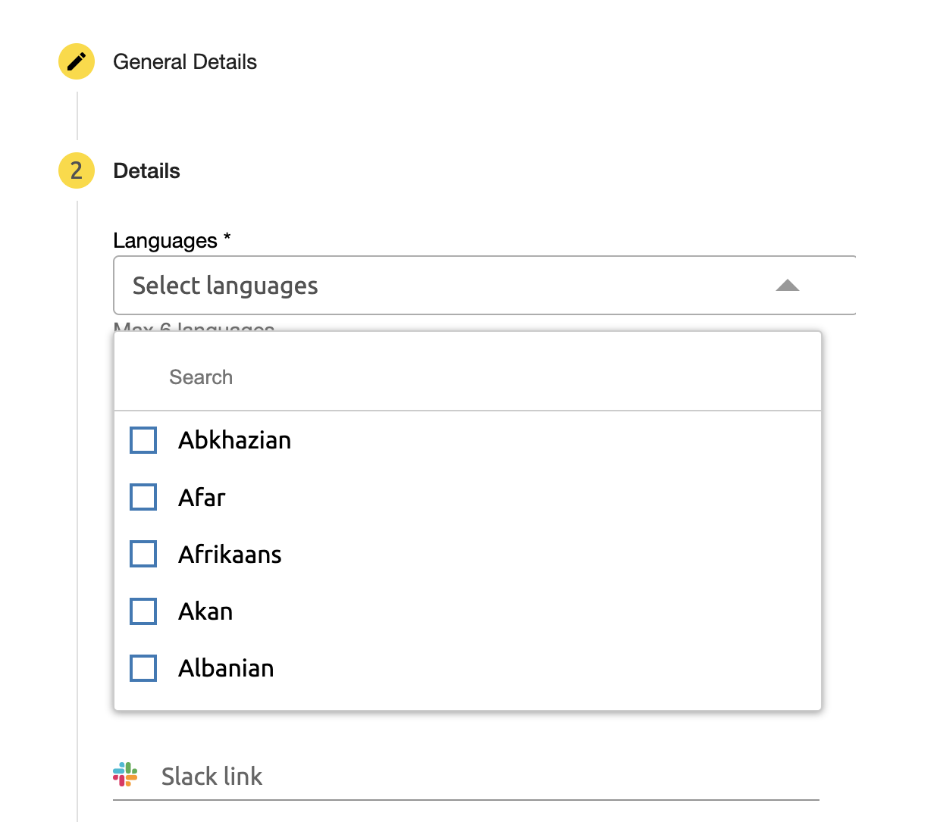
Edit Profile Details - Languages

Slide 22
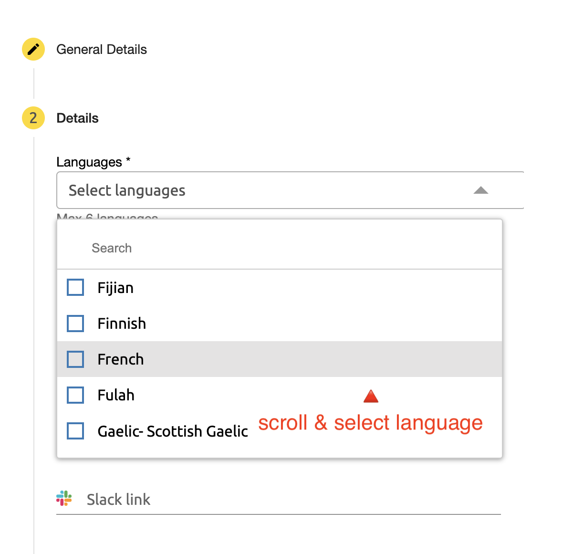
Edit Profile Details - Languages

Slide 23
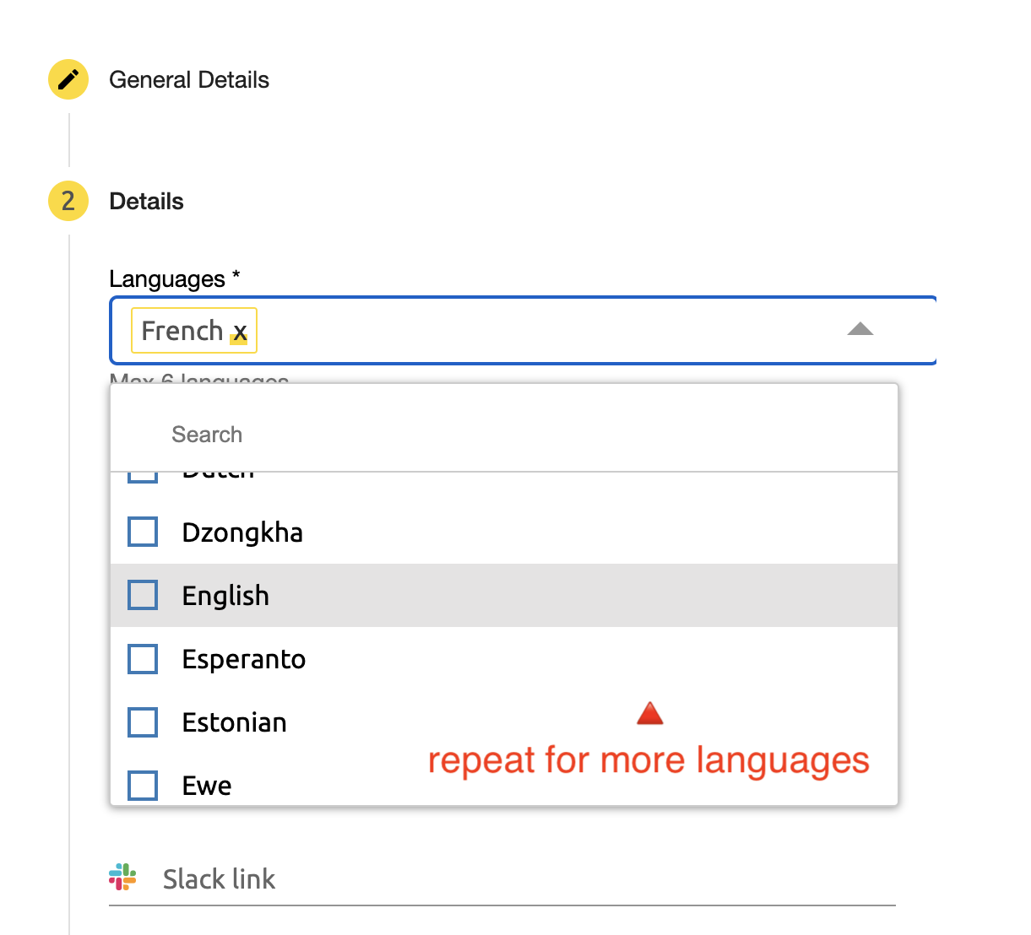
Edit Profile Details - Languages

Slide 24
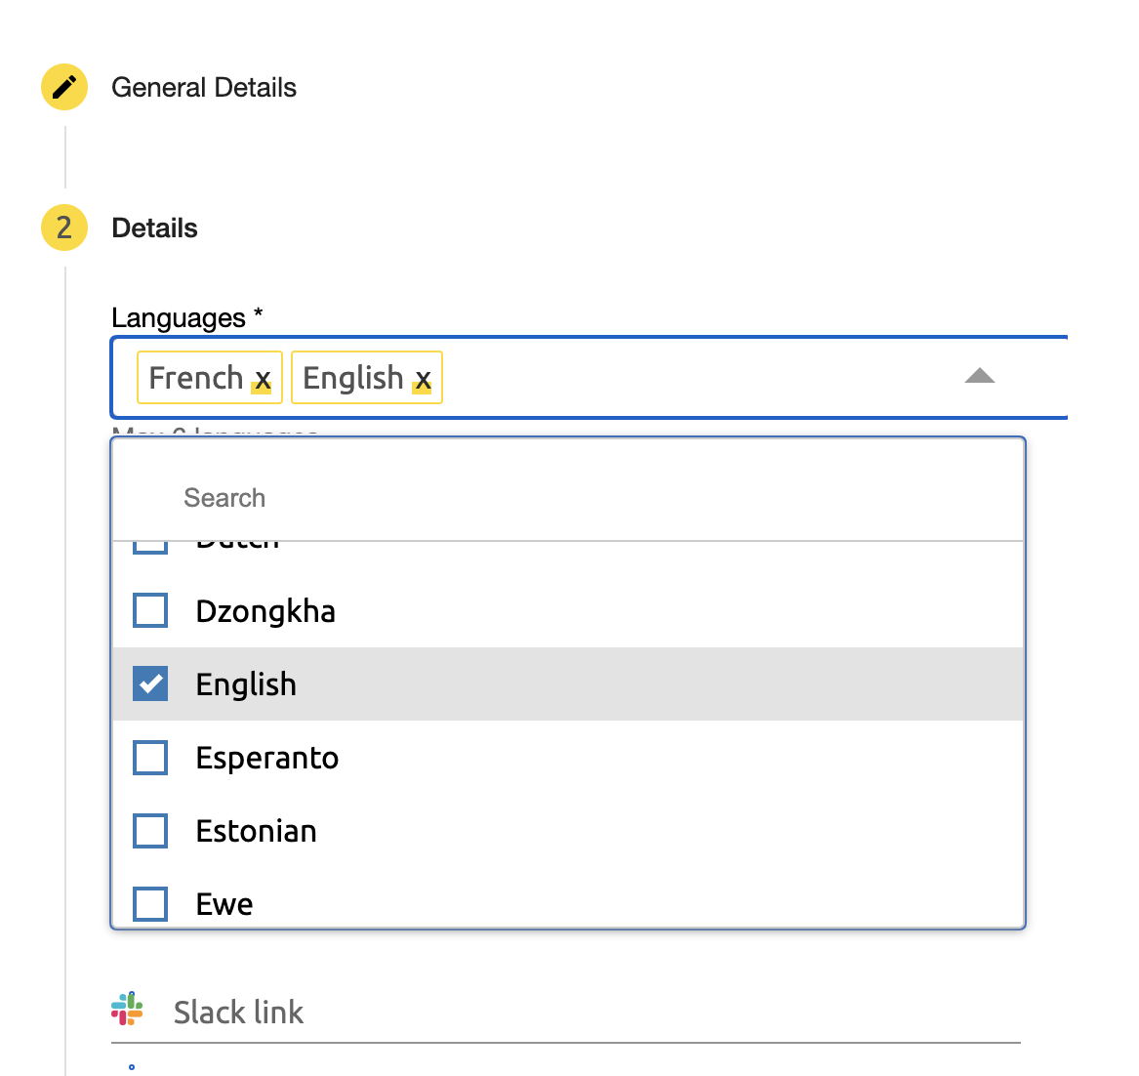
Edit Profile Details - Languages

Slide 25
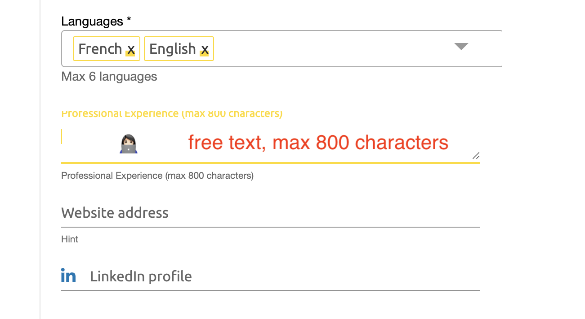
Edit Profile Details – Free Text

Slide 26
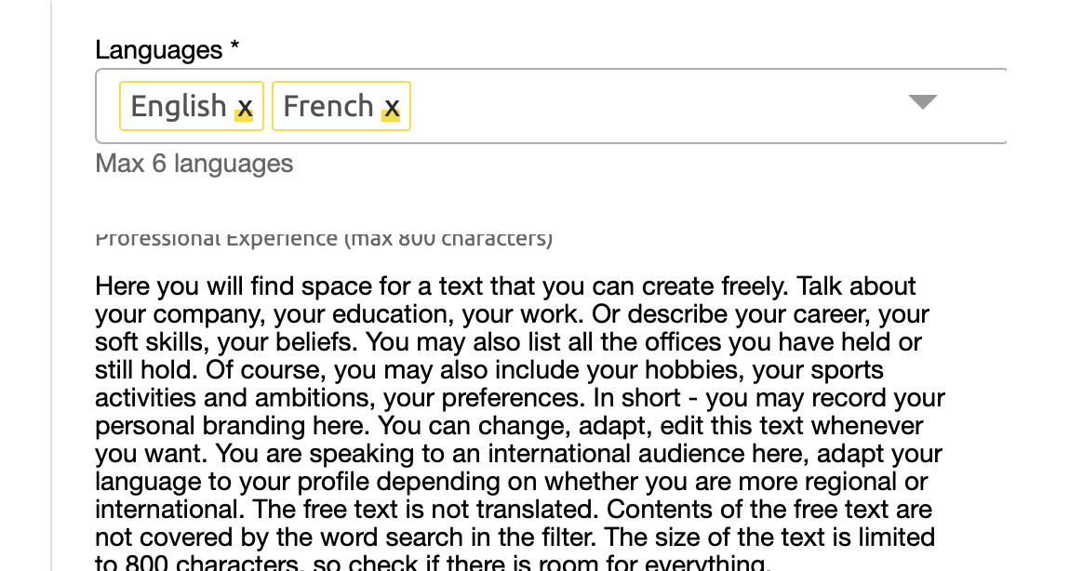
Edit Profile Details – Free Text

Slide 27
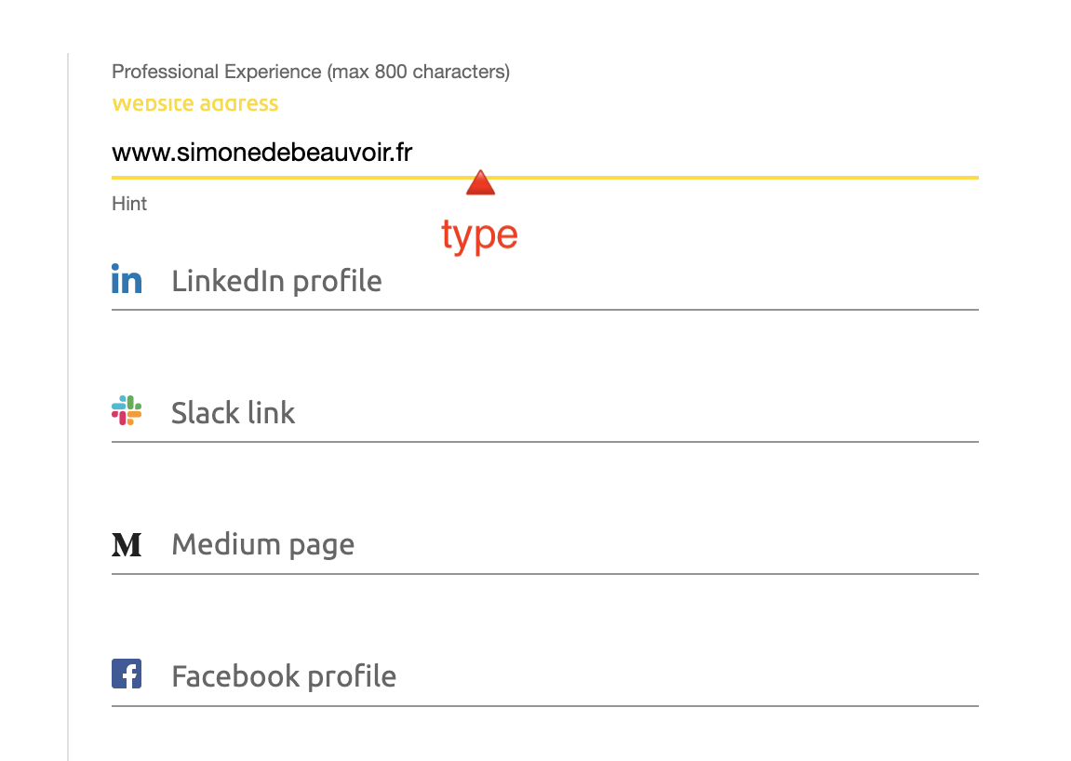
Edit Profile Details - Website

Slide 28
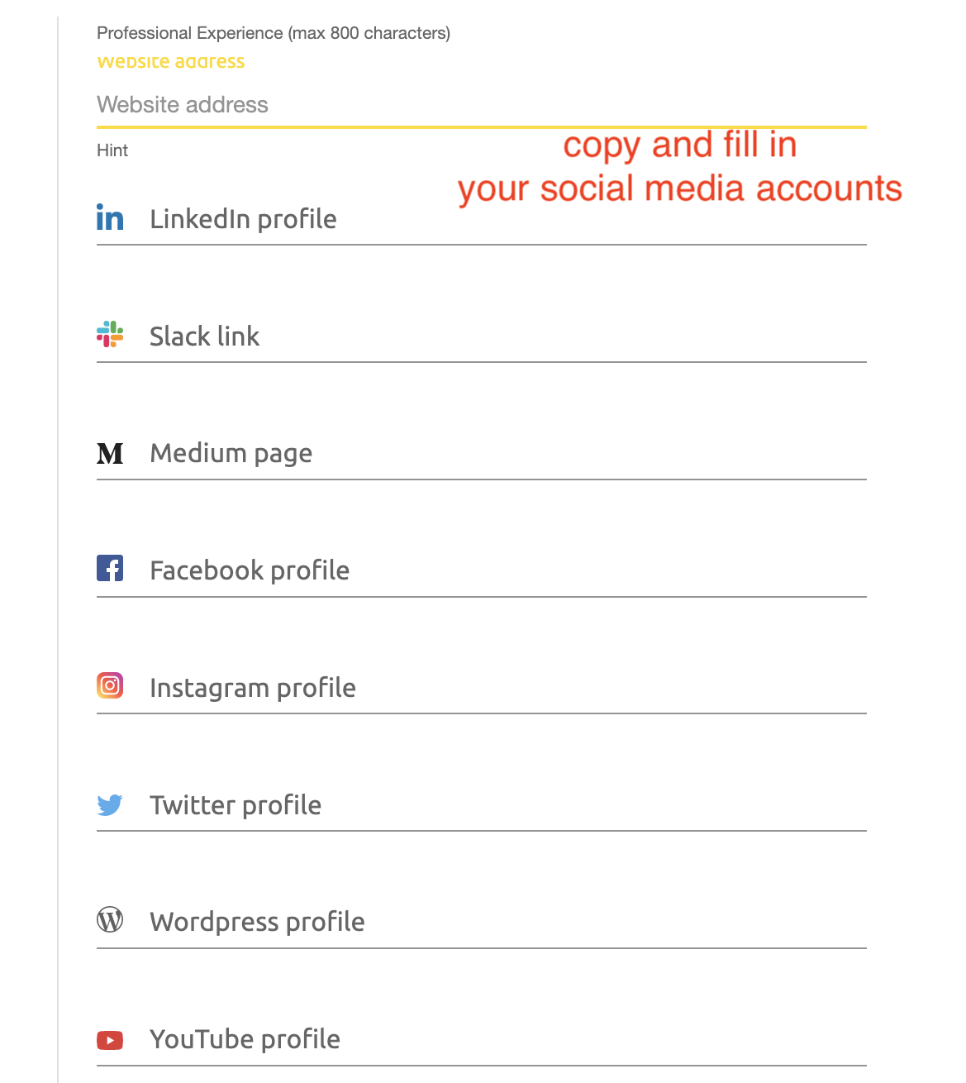
Edit Profile Details – Social Media

Slide 29
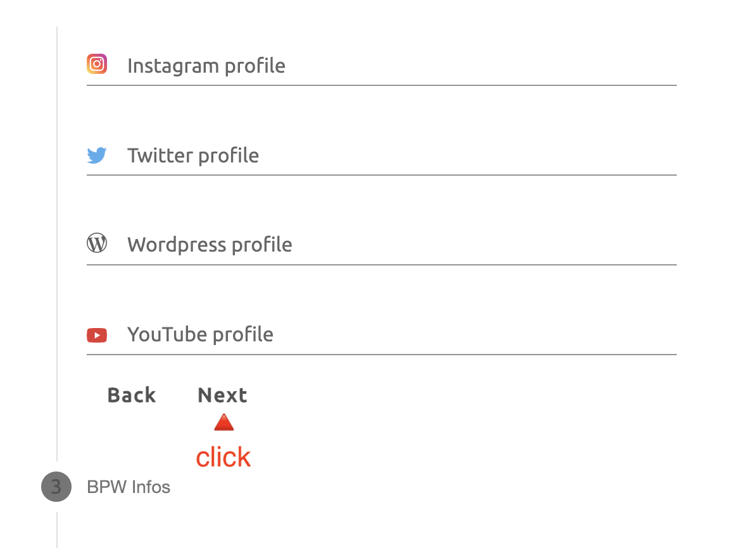

Slide 30
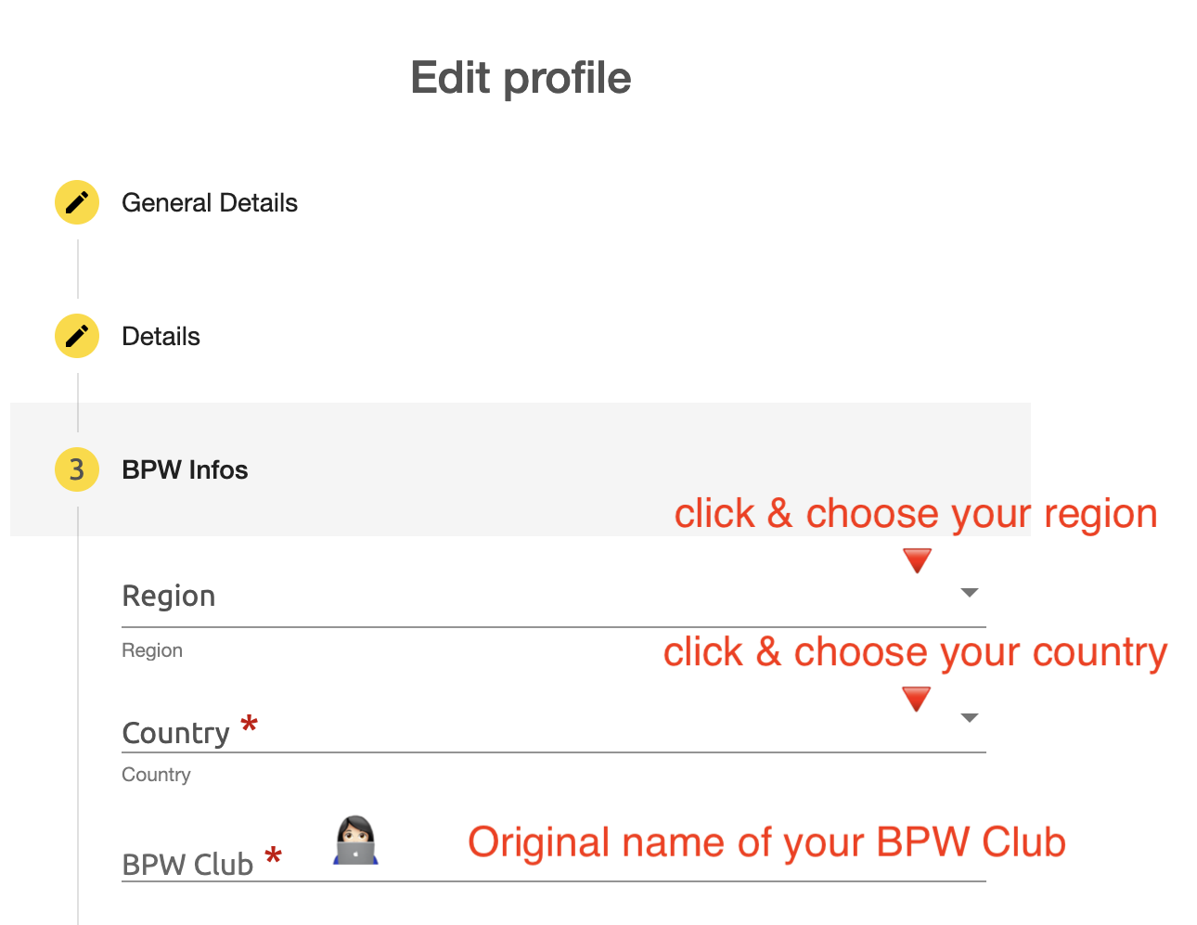
Edit Profile BPW Infos – Region, Country, Club

Slide 31
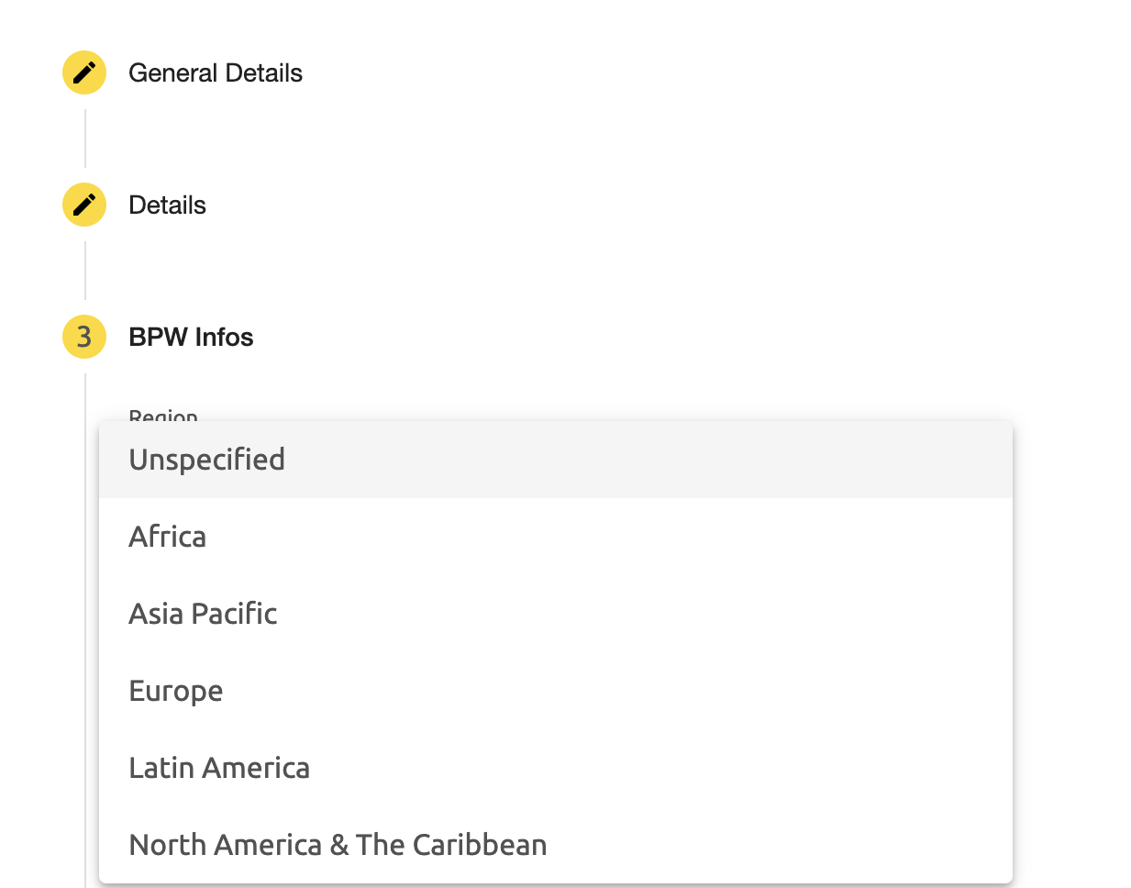
Edit Profile BPW Infos – Region

Slide 32
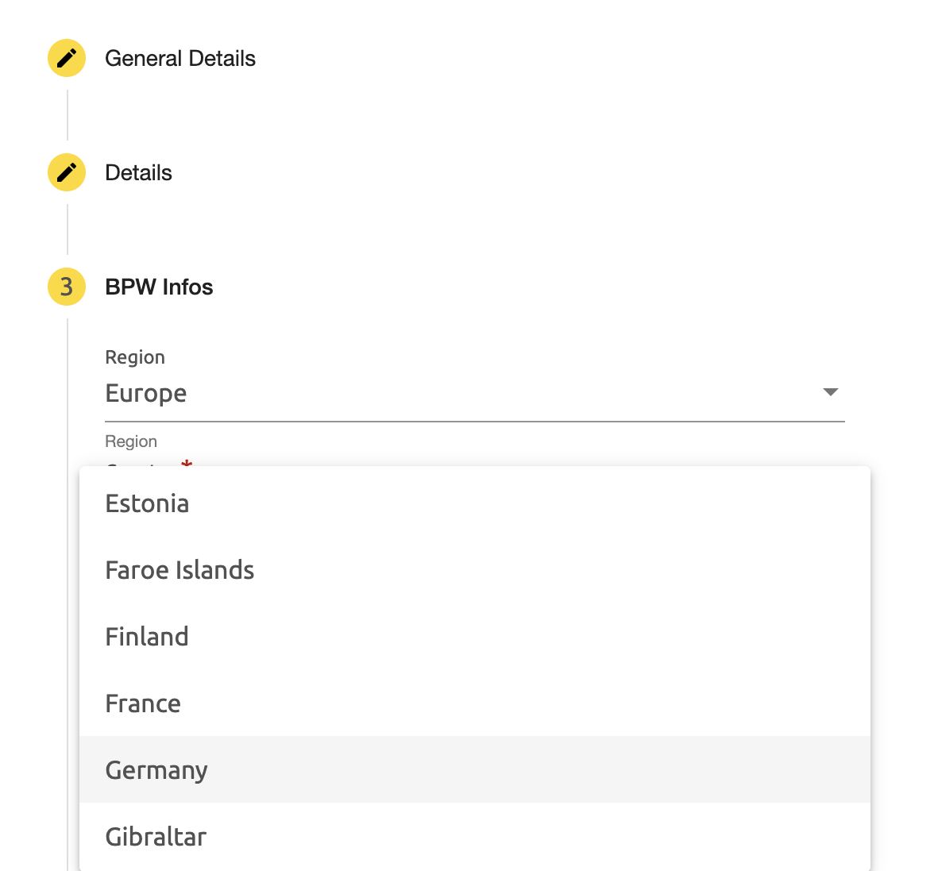
Edit Profile BPW Infos – Country

Slide 33
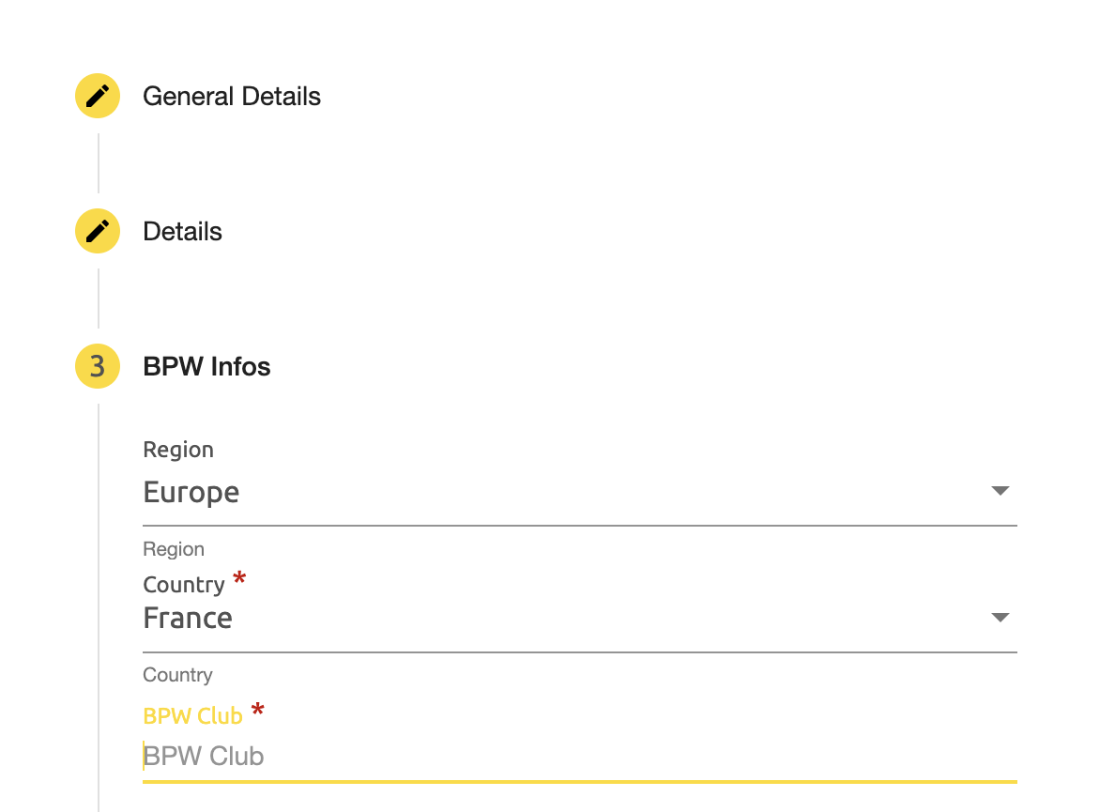
Edit Profile BPW Infos – Club

Slide 34
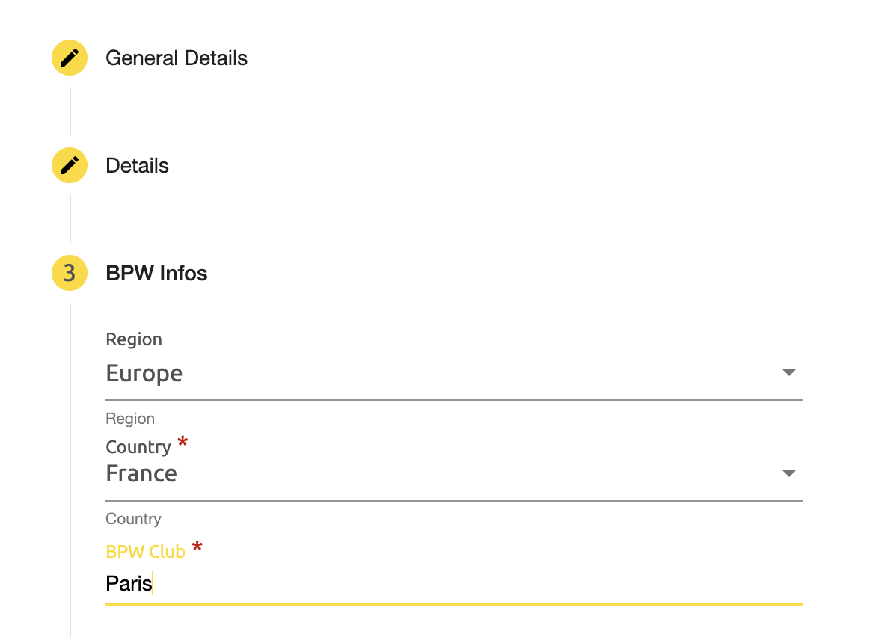
Edit Profile BPW Infos – Club

Slide 35
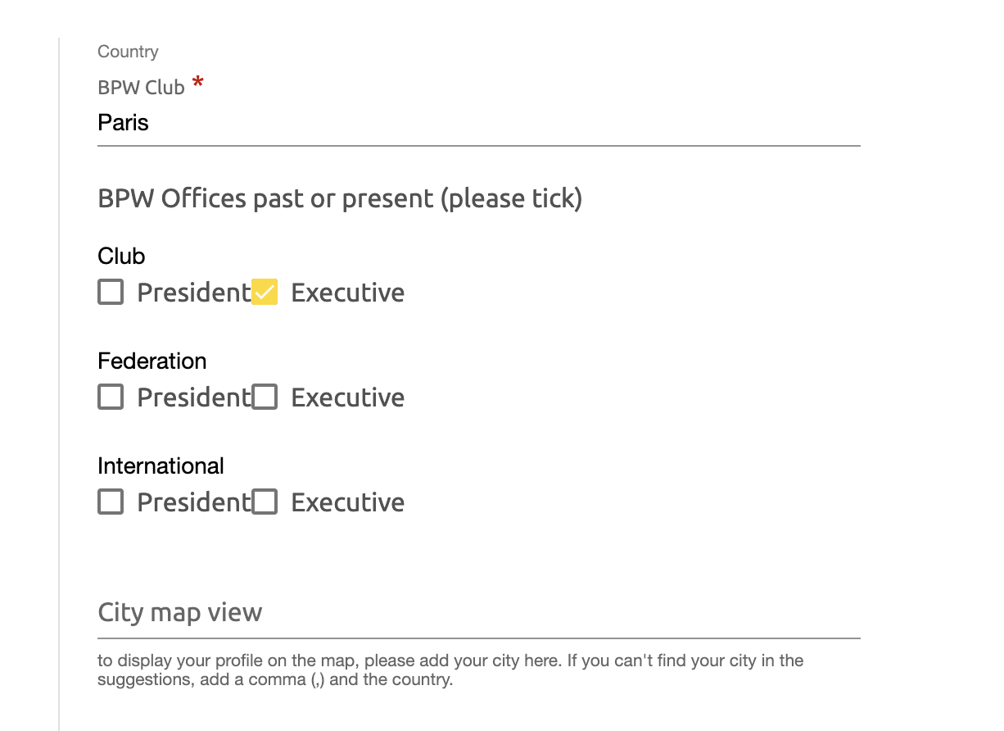
Edit Profile BPW Infos – BPW Offices

Slide 36
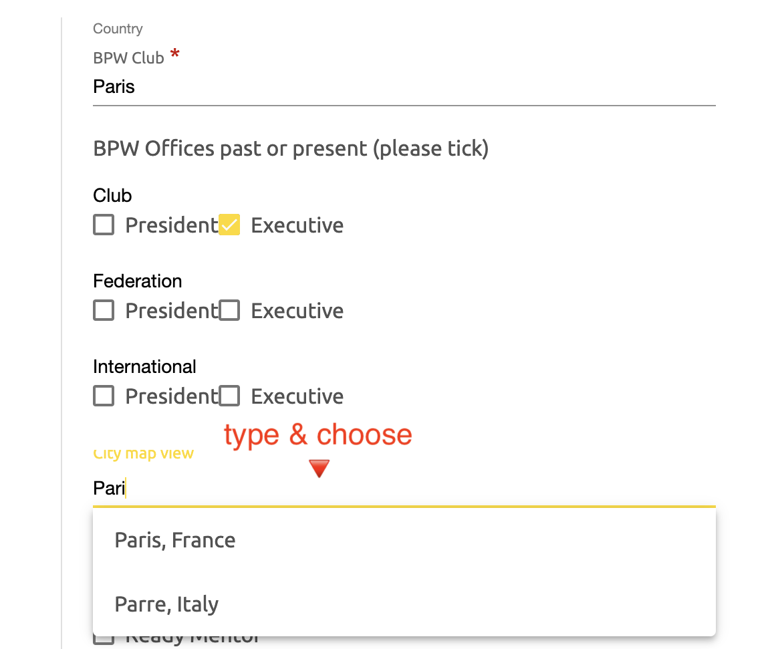
Edit Profile BPW Infos – City Map View

Slide 37
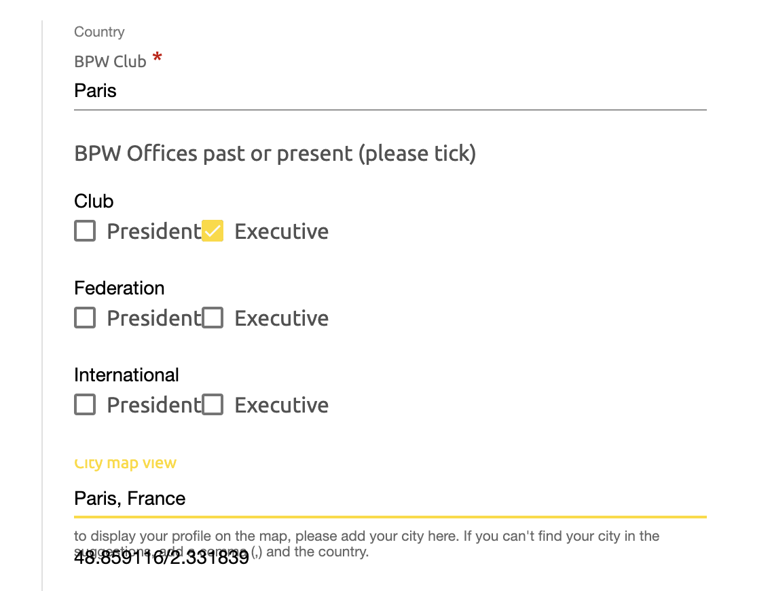
Edit Profile BPW Infos – City Map View

Slide 38
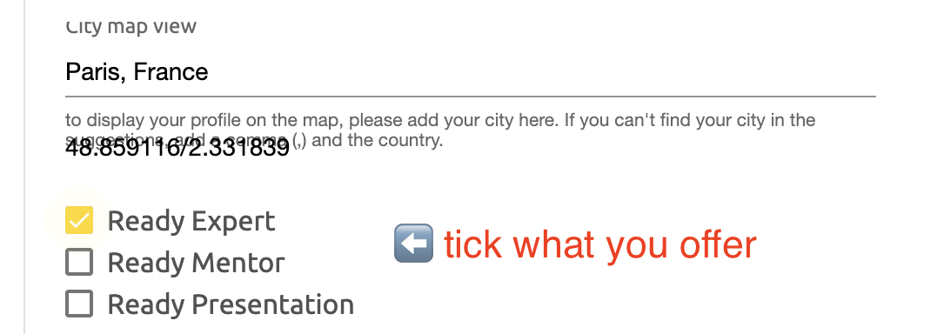
Edit Profile BPW Infos – Your Offers

Slide 39
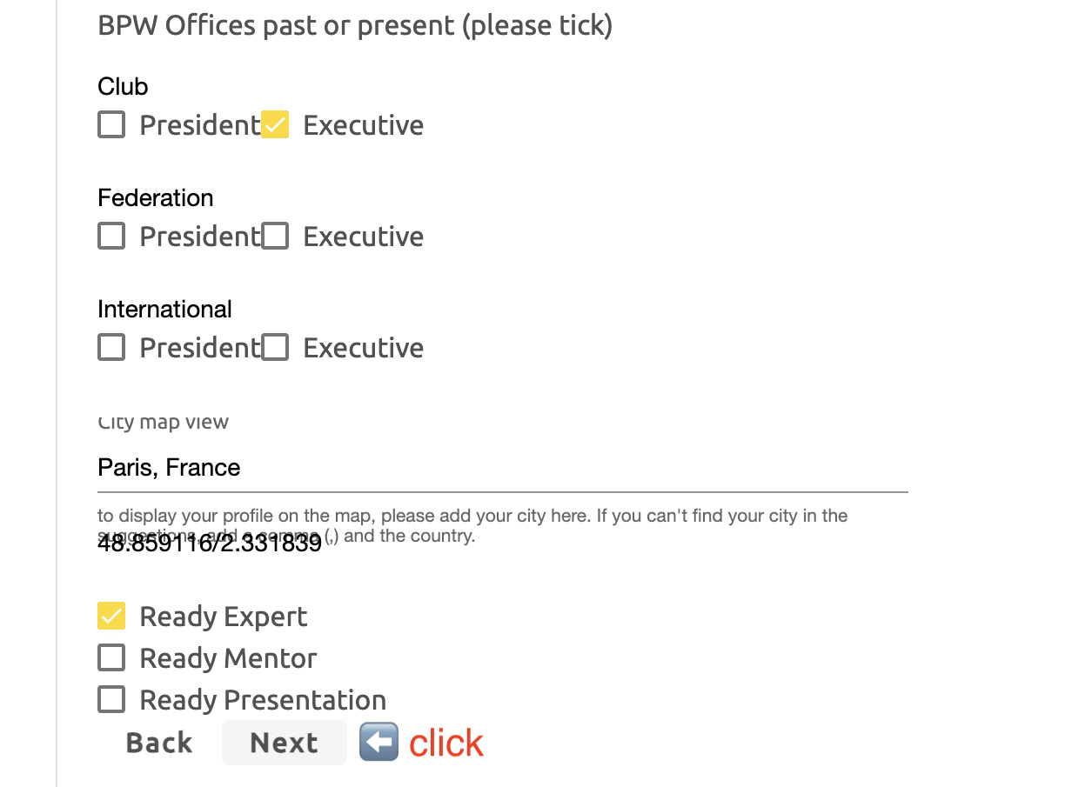

Slide 40
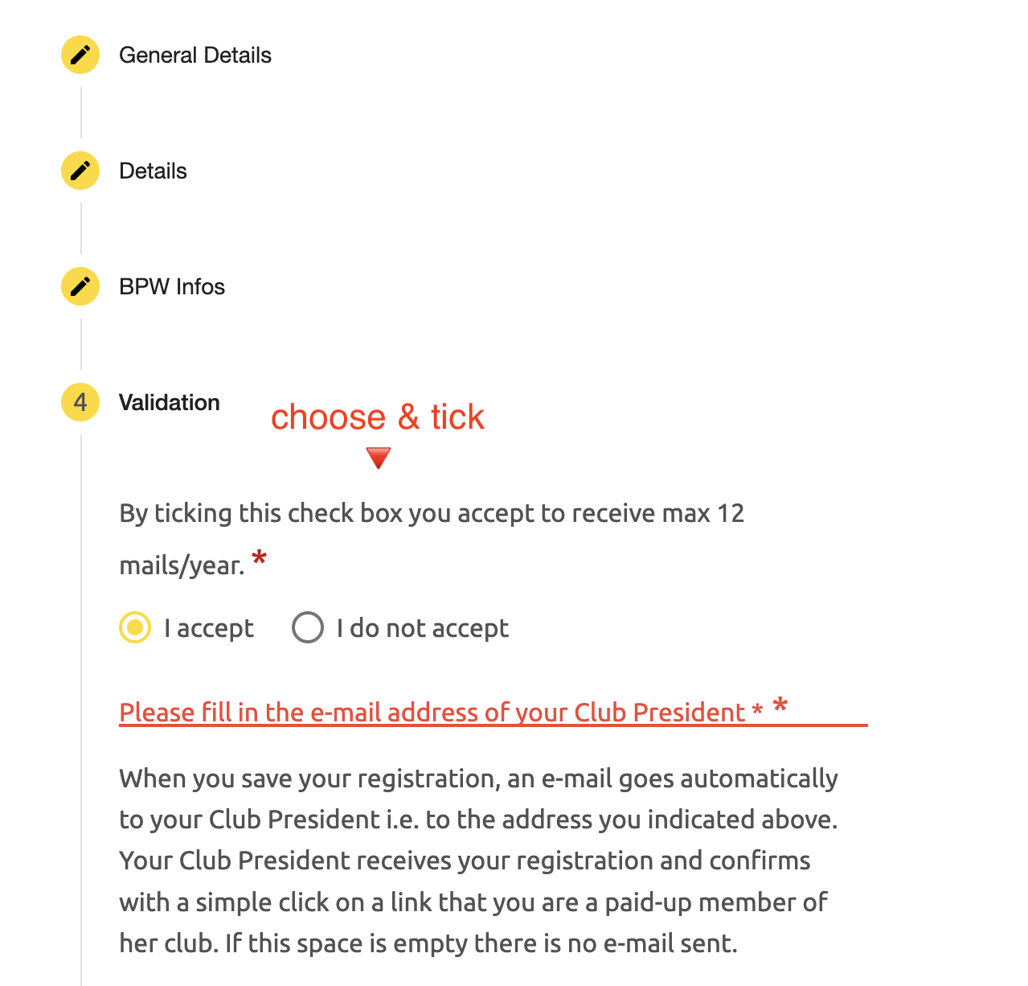
Edit Profile Validation – Directory Mailings

Slide 41
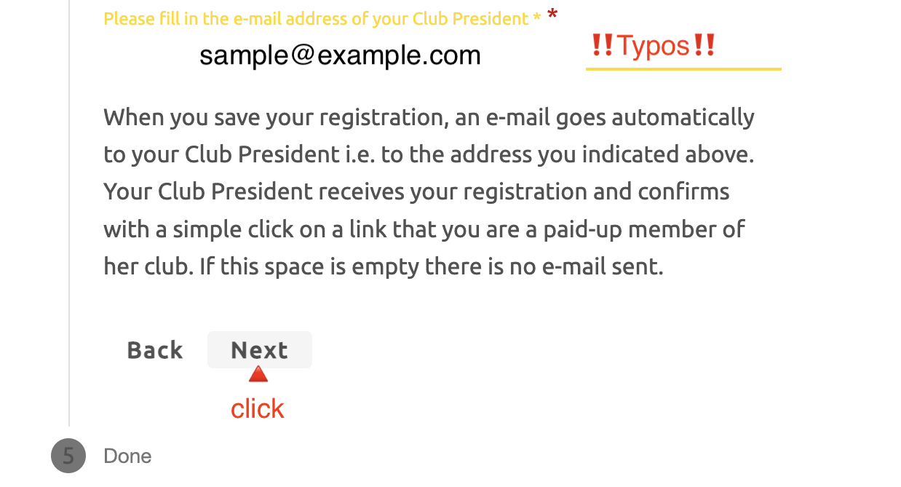
Edit Profile Validation - President‘s email address

Slide 42
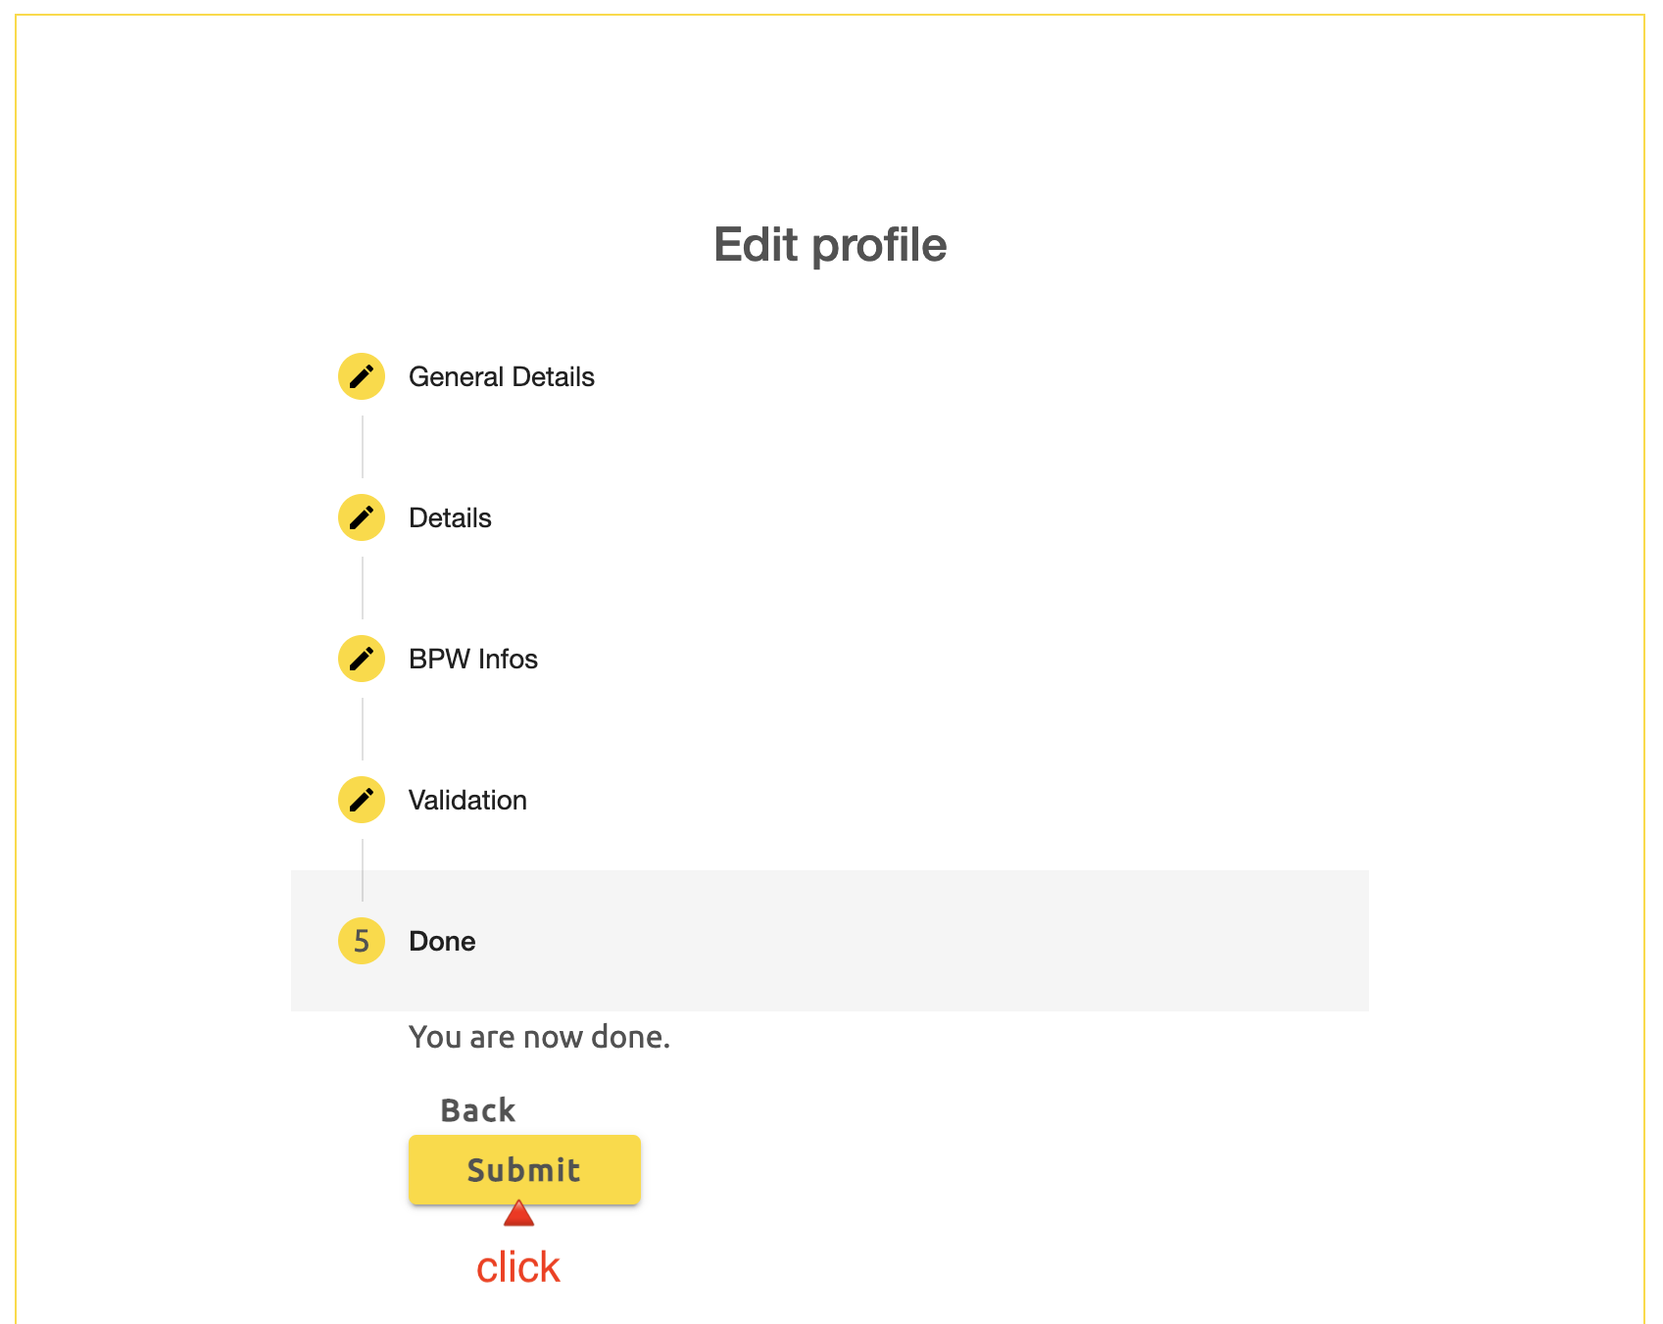

Slide 43
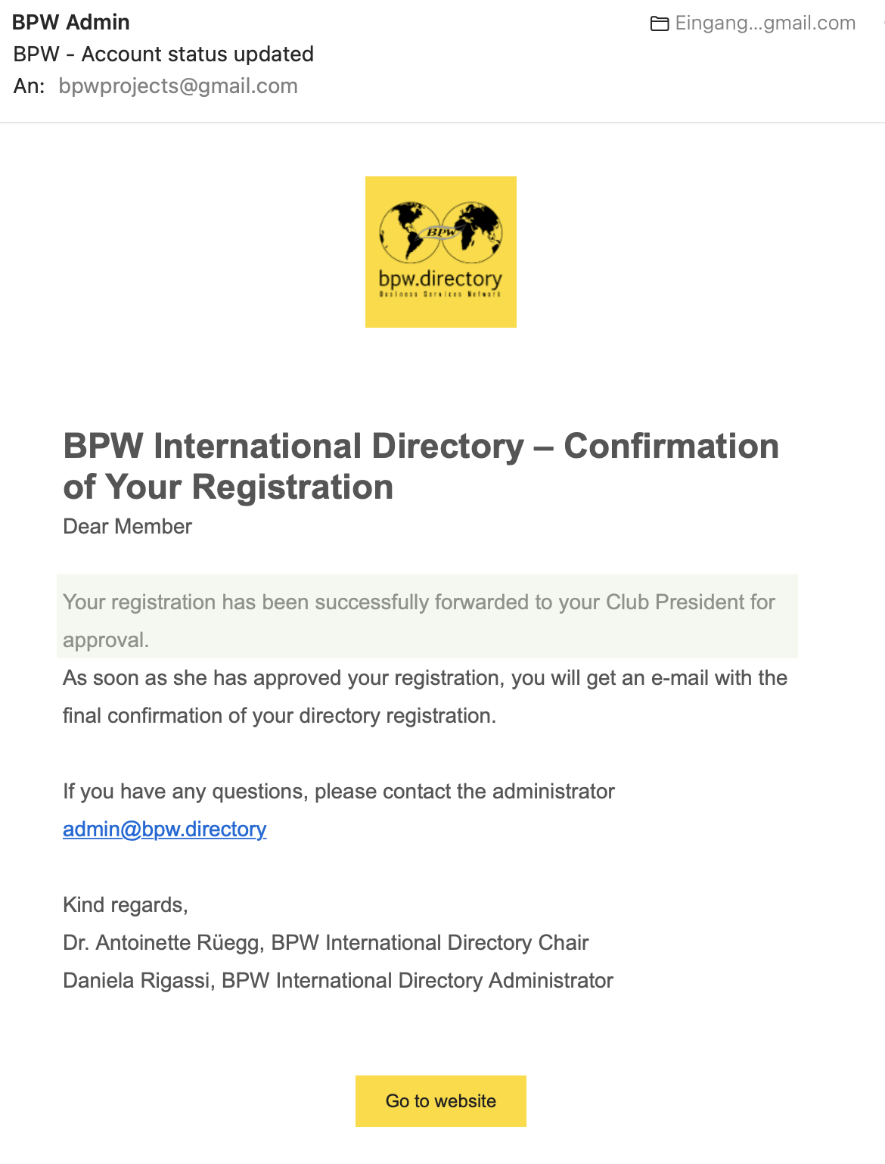
Check your emails.

Slide 44
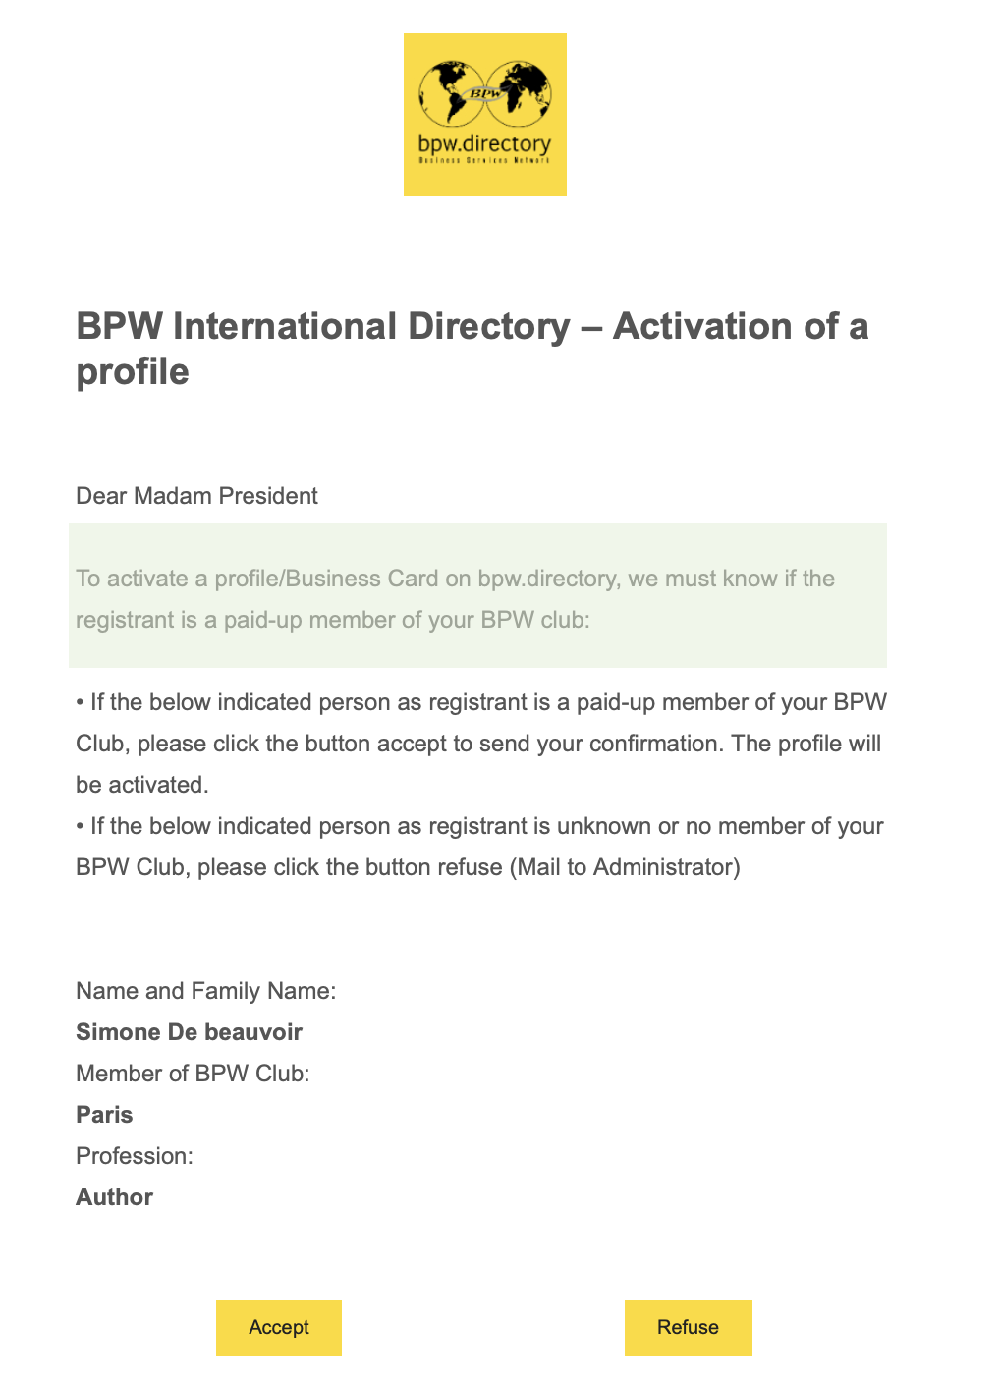
Activation of the Business Card
To Club Presidents:
Check your emails, also in spam.

Slide 45
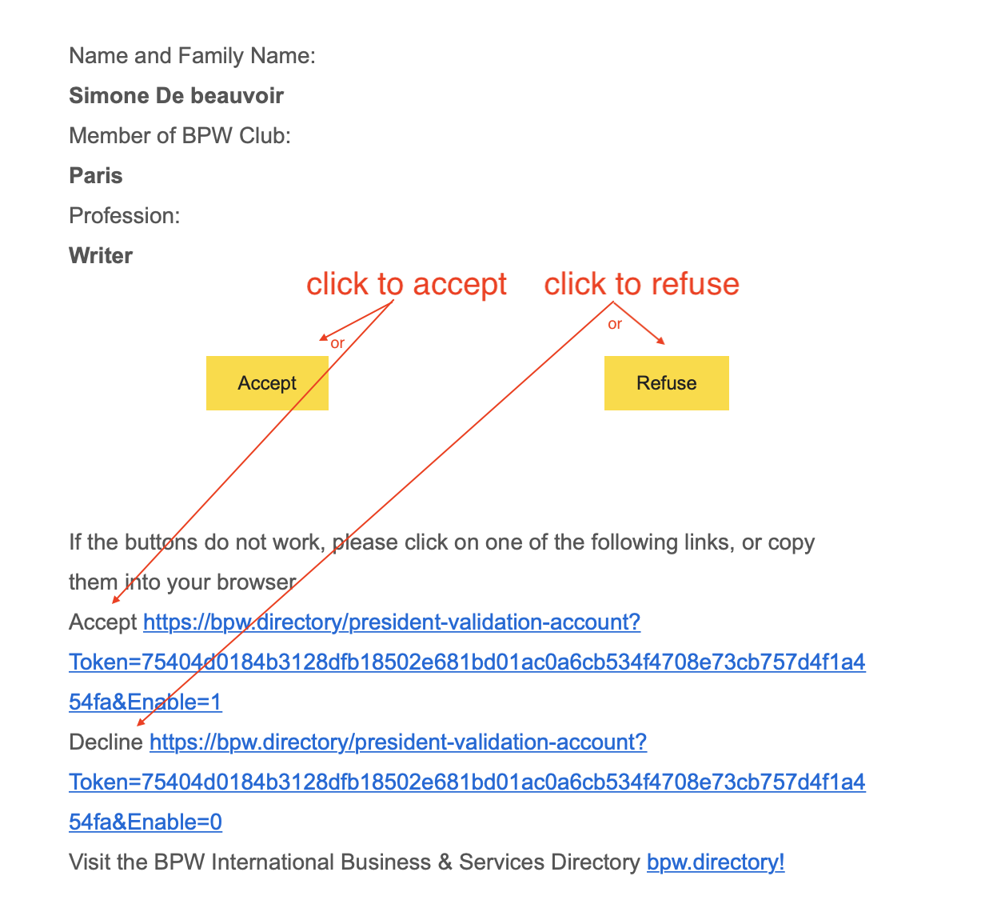
Activation of the Business Card
Accept – if paid
Refuse – if not paid

Slide 46
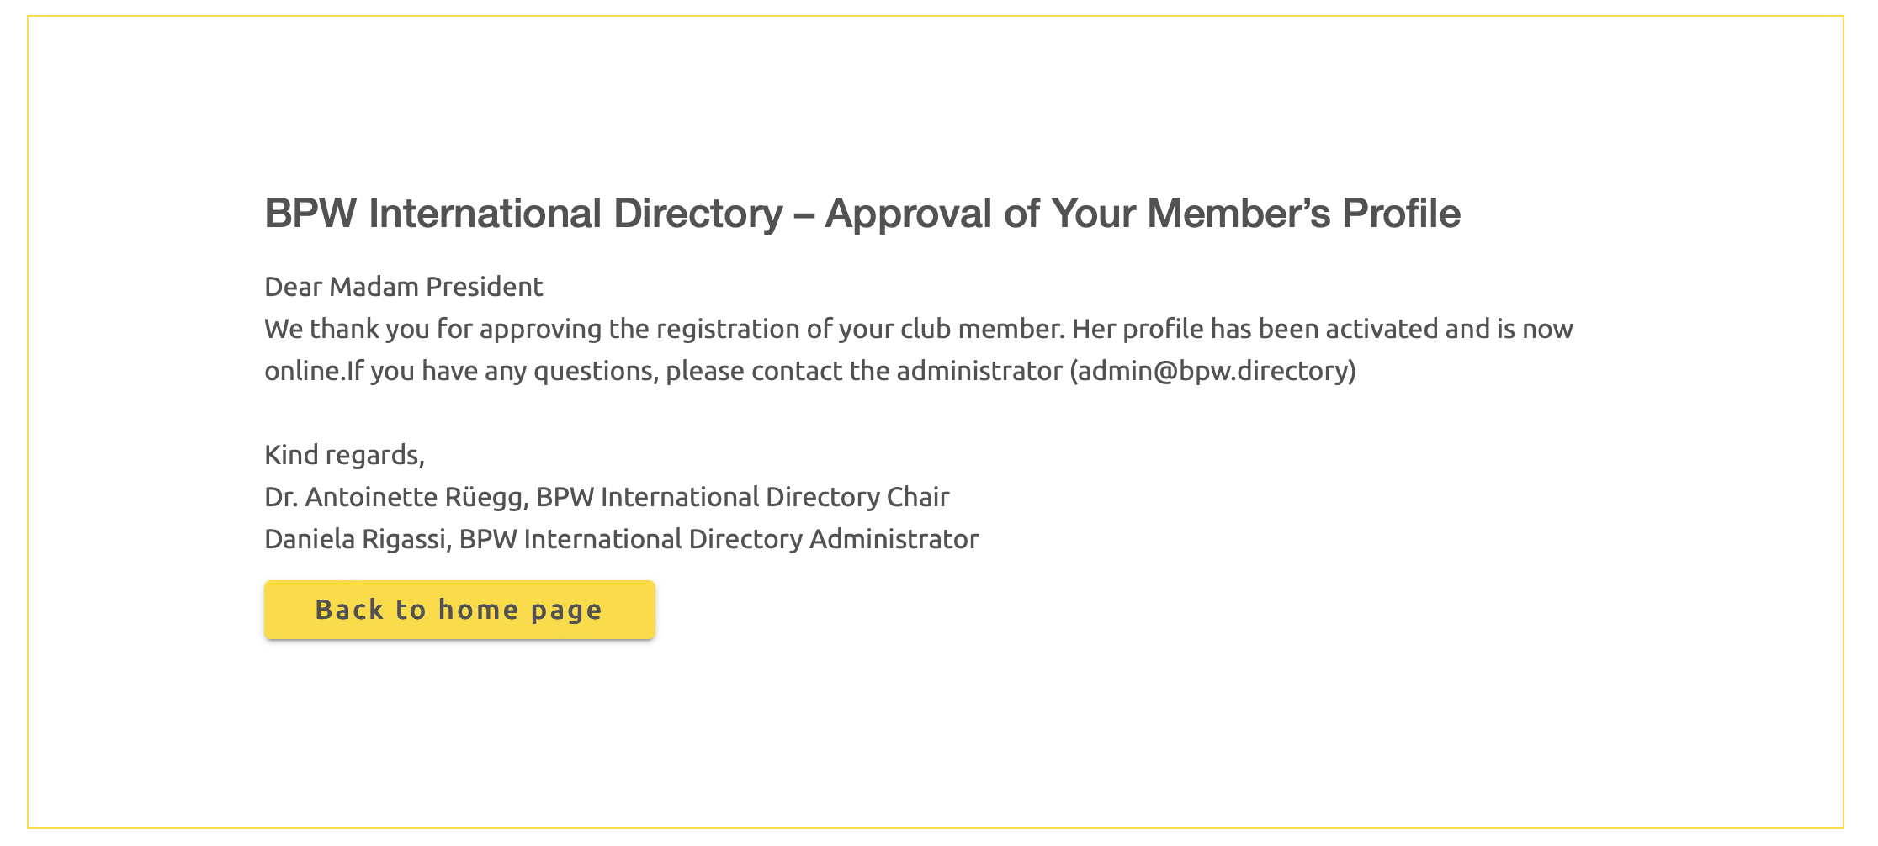
Message to the Club President – Approval of your Member’s Profile

Slide 47
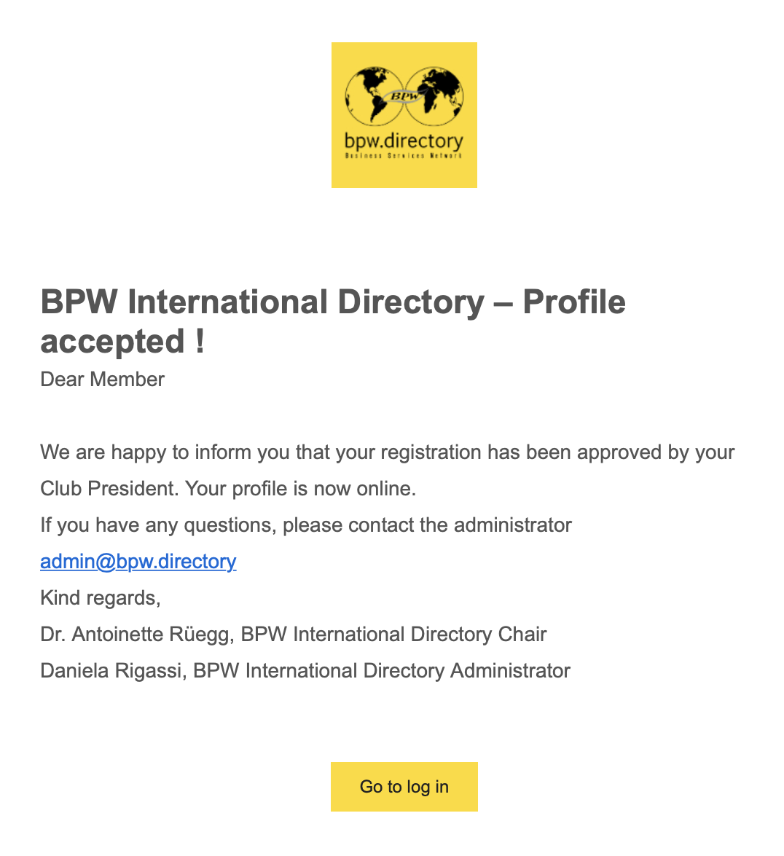
Check your emails – Profile activated!

Slide 48
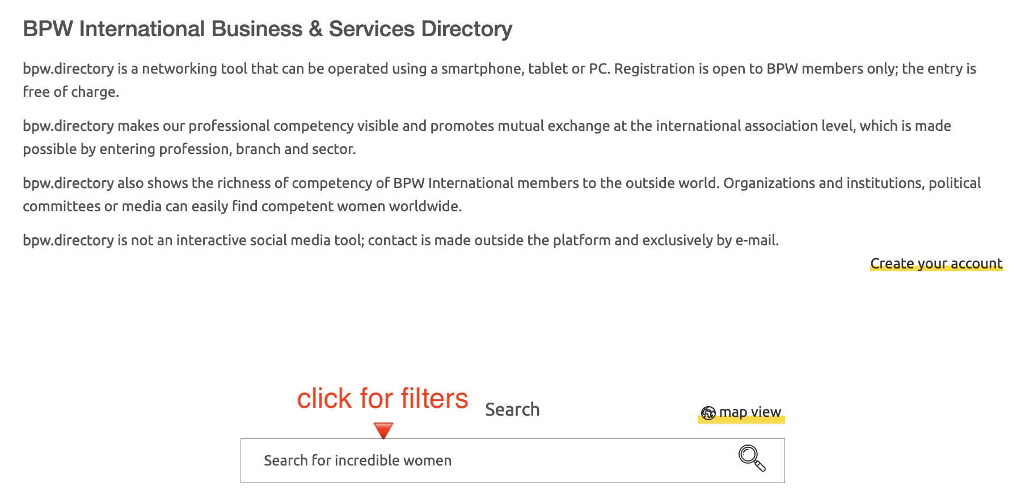
Find your Business Card - Search Filters

Slide 49
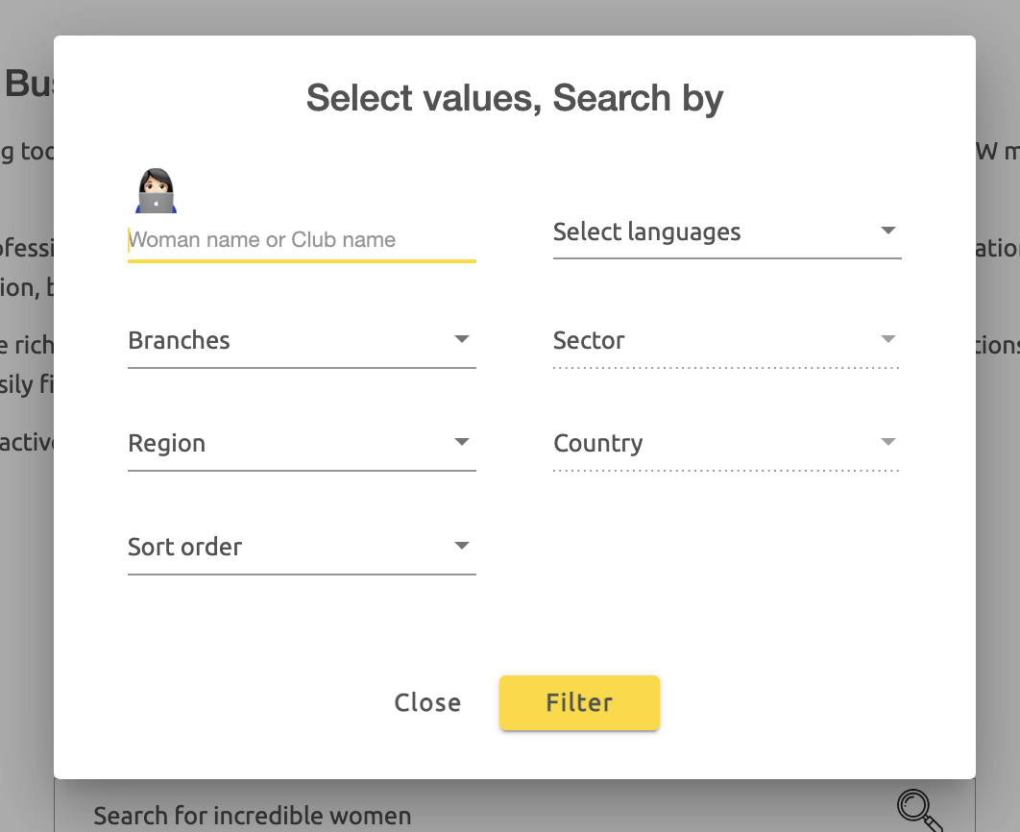
Search Filters

Slide 50
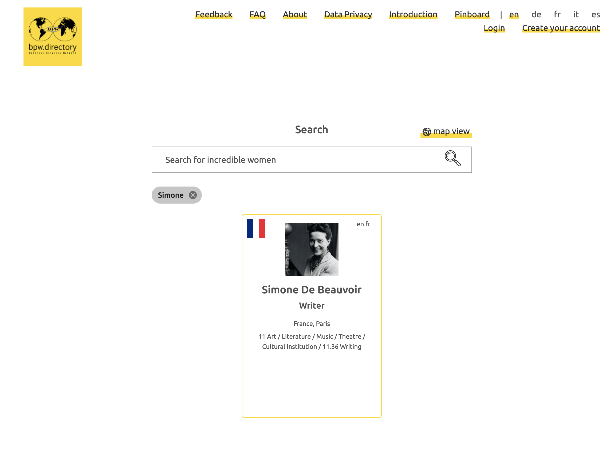
Search by name

Slide 51
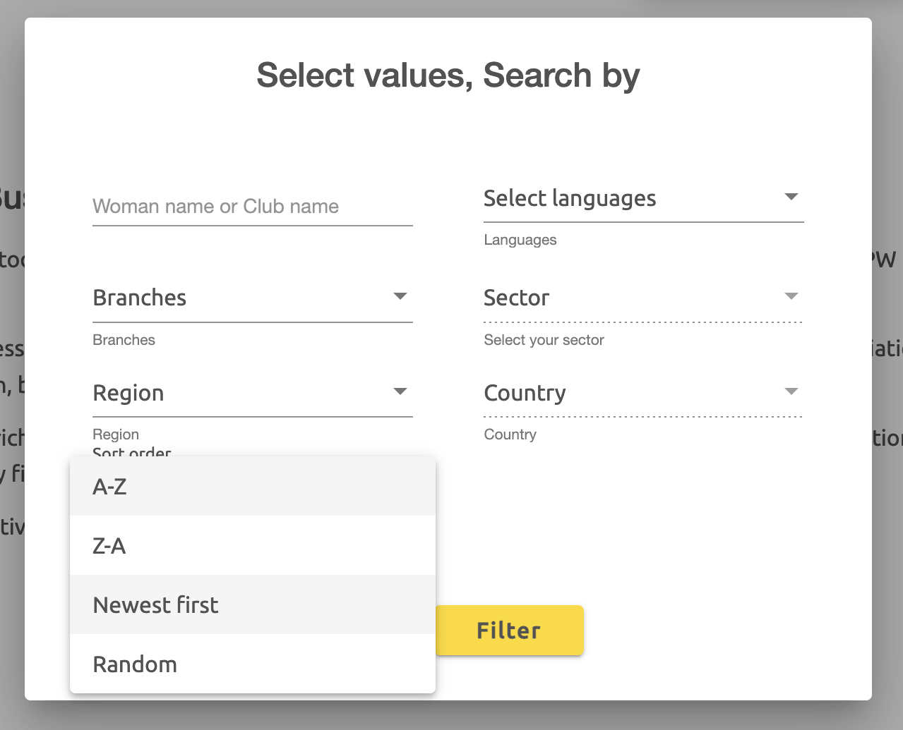
Search by Sort Order

Slide 52
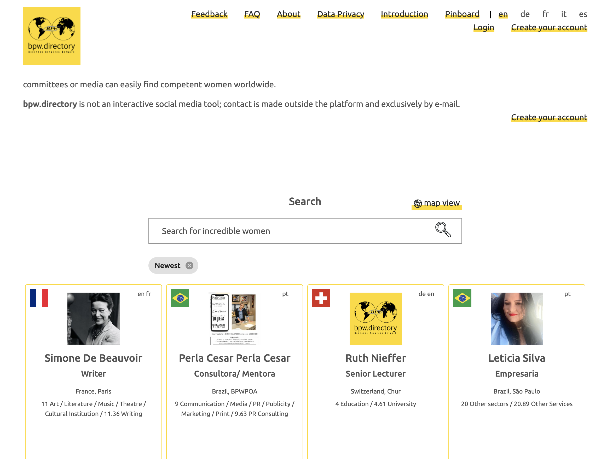
Search by Newest first

Slide 53

This is your Business Card

Slide 54

Search by Map View

Slide 55

Map View

Slide 56

Edit your Business Card

Slide 57

You are logged in

Slide 58

Settings

Slide 59

Settings – Email address of your president

Slide 60

Settings – Email address of your president

Slide 61

Settings – Reset Password

Slide 62

Settings – Reset Password

Slide 63

Settings – BPW Directory Mailings

Slide 64

Settings – BPW Directory Mailings

Slide 65

Contact a BPW Member

Slide 66

Contact page

Slide 67

www.bpw-international.org

