Slide 1

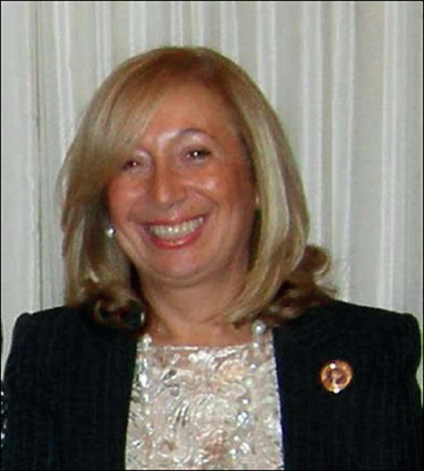
Task Force : Child Marriage Prevention
Report 2023
Giuseppina Seidita
Task Force “Child Marriage Prevention” Chair

Slide 2
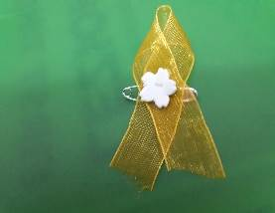
THE MEMBERS OF THE TASKFORCE
First and Last Name | Chair/Member | BPW Region
Giuseppina Seidita | Chair | Europe Region -Italy
Dana Sas | Member | Europe Region- Romania
Victoria Anzola | Member | Latin America Region-Colombia
Rasmata Kabre Krishni Hettiaratchi | Member Member | Africa Region-Burkina Faso North America&Caribbean- Canada
Nasreen Mahdi | Member | Asia Pacific Region-Pakistan

Slide 3
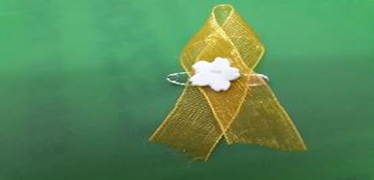

THE DEFINITION OF CHILD MARRIAGE?
The most commonly used definition of child marriage is 'marriage before before the age of 18", the age limit for the protection of children under the Convention on the Rights of the Child

Slide 4
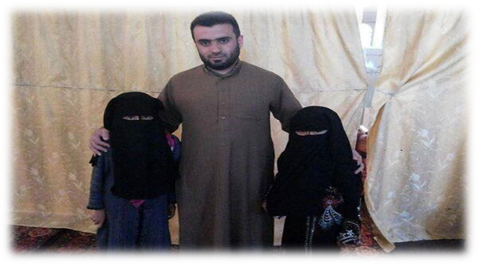
Child marriage is a serious violation of human rights and we cannot allow it.Statistics show that every three seconds a girl under the age of 18 is married - that means 10 million underage girls are married every year - mostly without their consent and most likely to an older man.

Slide 5
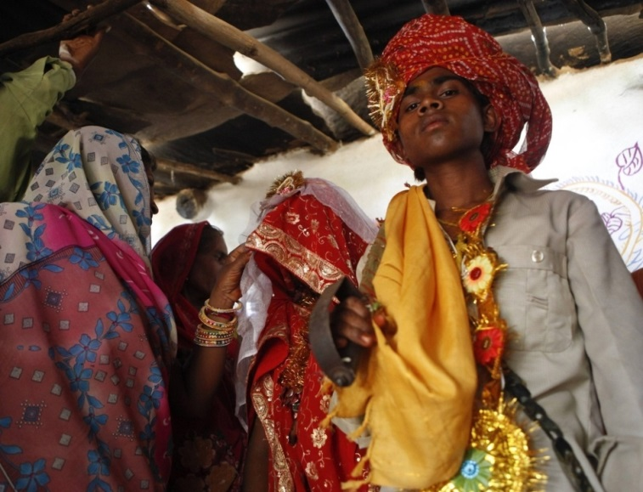
OVERVIEW
Many girls around the world are forced into marriage without the opportunity to exercise their right to choose. Some are forced into marriage at a very young age. Often they appear to have given their 'consent', but in reality it was given by others on their behalf. Parents and family heads decide on the marriage of their daughters. They see marriage as a strategy for family stability, a financial arrangement or a way to protect girls from unwanted sexual advances.

Slide 6
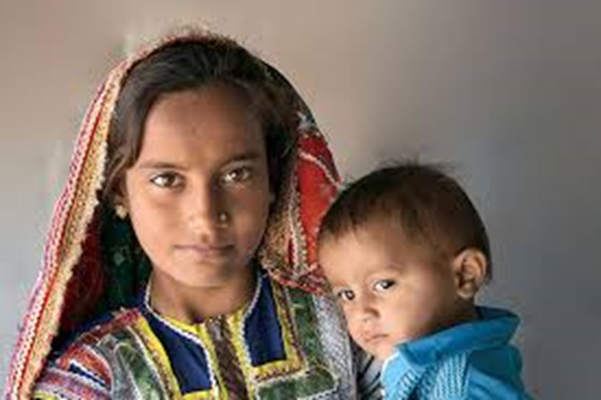
Child marriage jeopardises efforts to reduce gender-based violence, increase education, overcome poverty and improve health indicators for girls and women. Child brides are often forced into early sexual activity and soon become pregnant. Most countries have adopted laws to control the spread of this phenomenon, but other customary and religious laws have a greater influence on family life or personal matters.

Slide 7
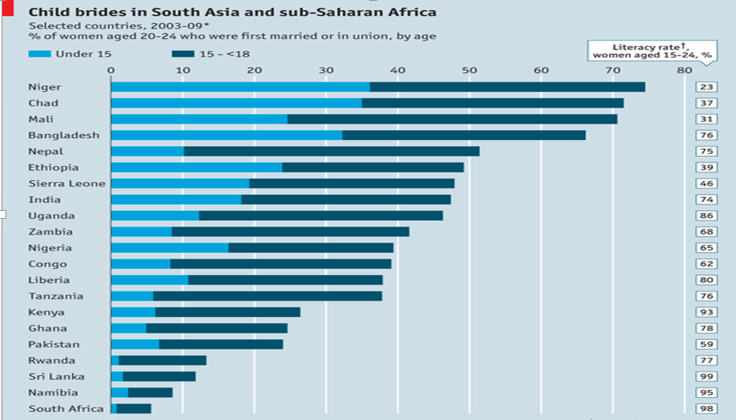
Most of these marriages take place in Africa, mainly in sub-Saharan Africa. According to the UNICEF Research Digest, Africa has the highest incidence of child marriage. Demographic and health data for Africa show that in Niger, Chad and Mali, more than 70% of girls are married before the age of 18.

Slide 8
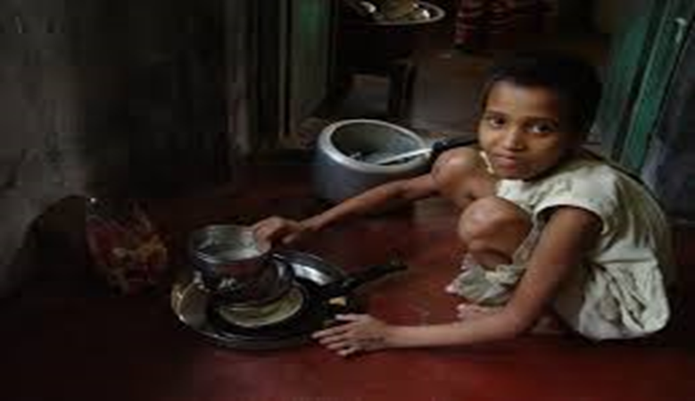
The most serious health risk is obstetric fistula, which is caused when a young mother has many lacerations during childbirth, resulting in the loss of urine and faeces.
Another health risk for adolescent girls who are married is HIV/AIDS infection.

Slide 9

Our activities in this period.
We are doing an information and awareness campaign about child marriage in the world.
Our campaign includes some meetings in different BPW regions with some testimonies.
Representatives from UNICEF and other international organisations took part in the meetings.
We want to create a network between our clubs and other organisations around the world to work together against this sad phenomenon.

Slide 10
We believe it is necessary to raise awareness among governments.
We are preparing projects to improve the economic empowerment and health education of women and girls.
We want to achieve a cultural change through education, because this is the best tool to fight the phenomenon.

Slide 11
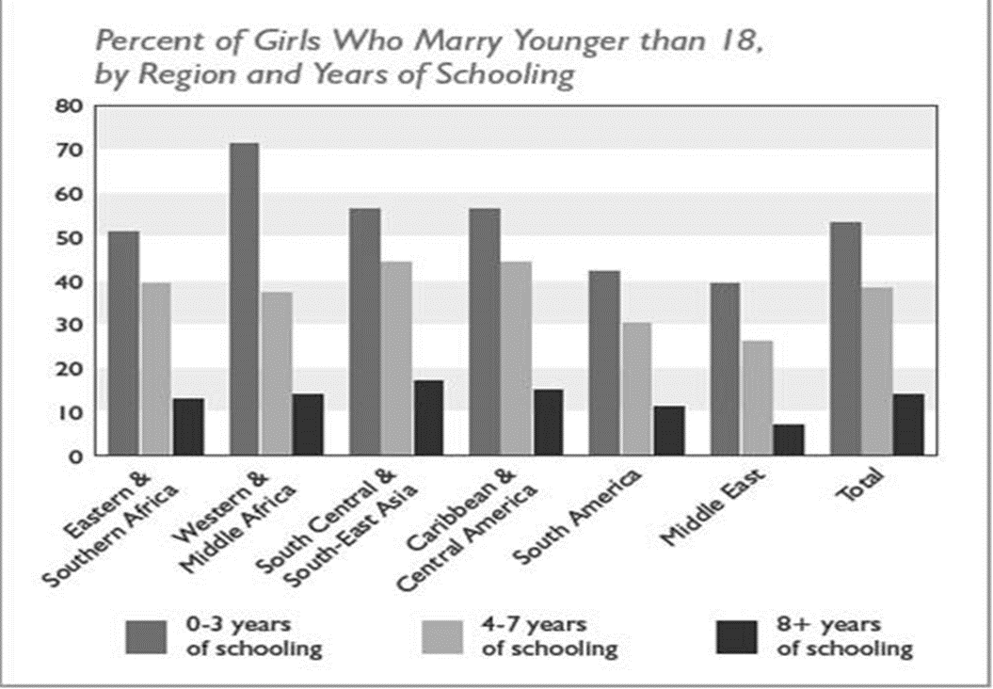
The child marriages are closely associated with the lack or low levels of schooling for girls.
Font: Young to Wed: Education & Action Toward Ending Child Marriage: International Centre for Research on Women.

Slide 12
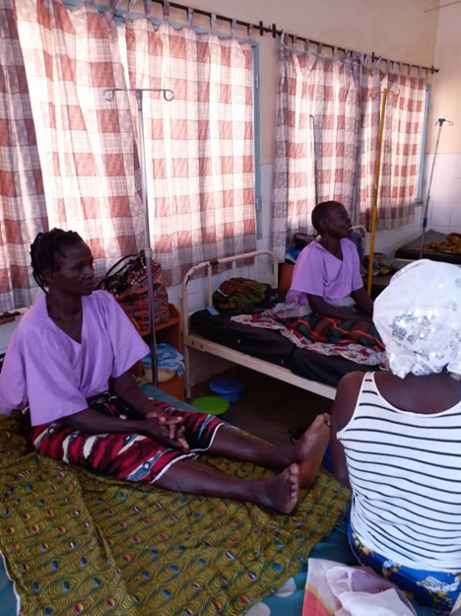
In Burkina Faso, Taskforce member :Rasmata Kabre is implementing a project to help young women with obstetric fistula.
She provides them with accommodation, health care and education in a centre.
The accomodation center in Burkina Faso

Slide 13
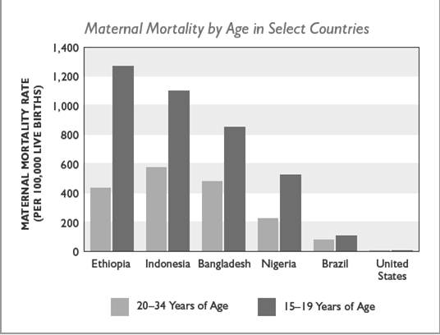

Slide 14
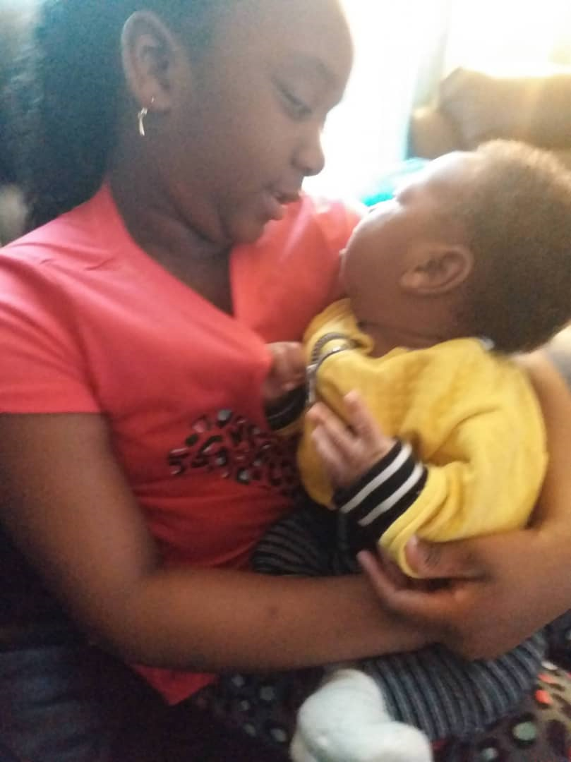
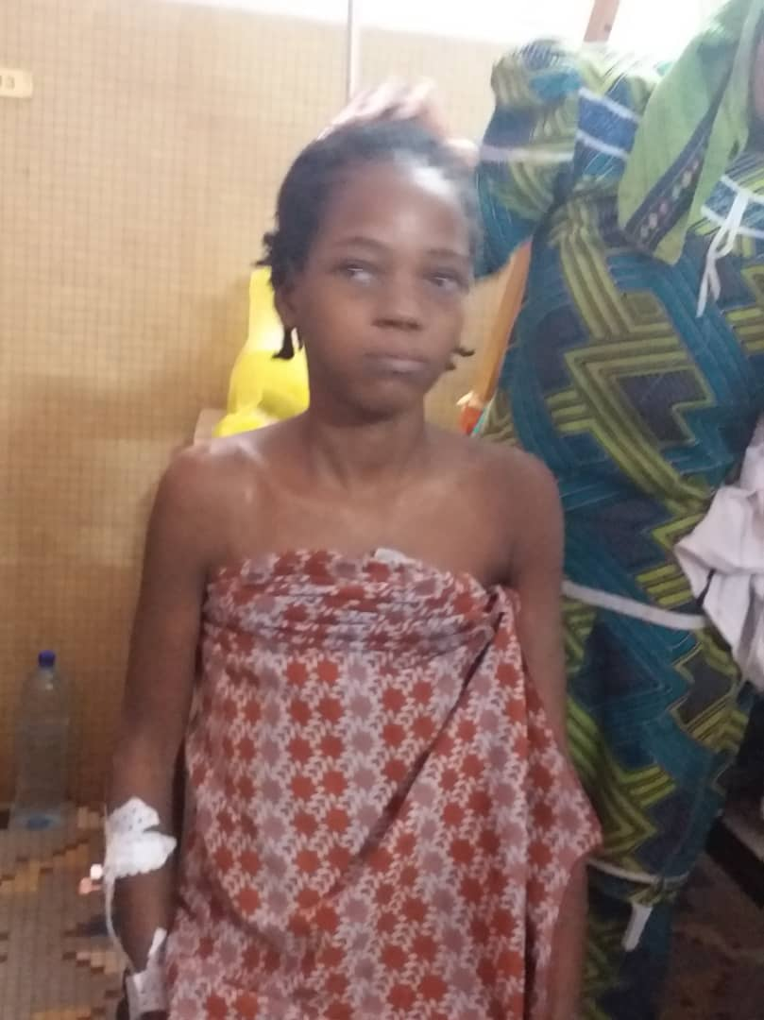
A 14-year-old girl who was forced to marry, gave birth and lost her baby, found herself with obstetric fistula in the accommodation centre.
A 14-year-old girl who was forced into marriage and discovered she had an obstetric fistula.

Slide 15
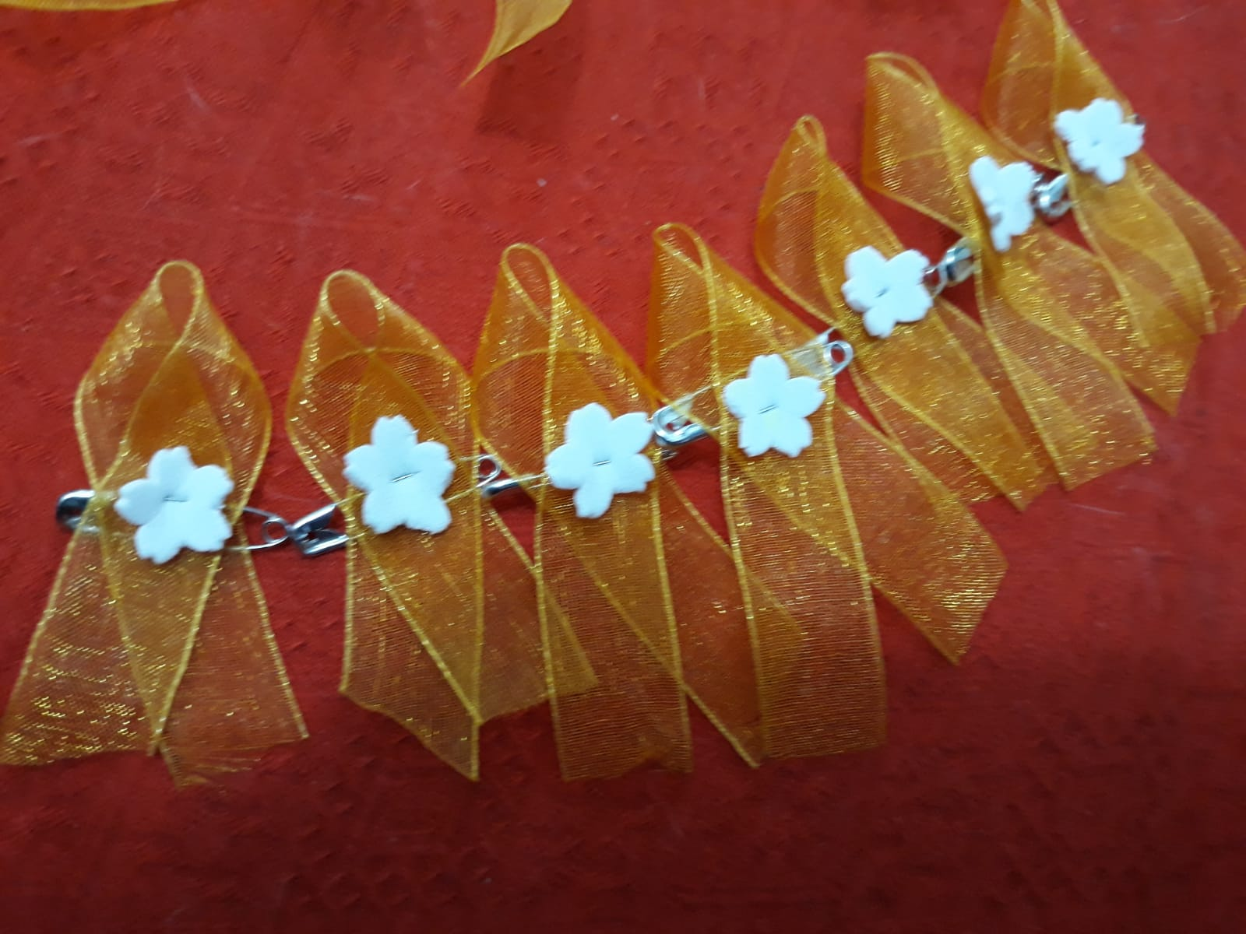
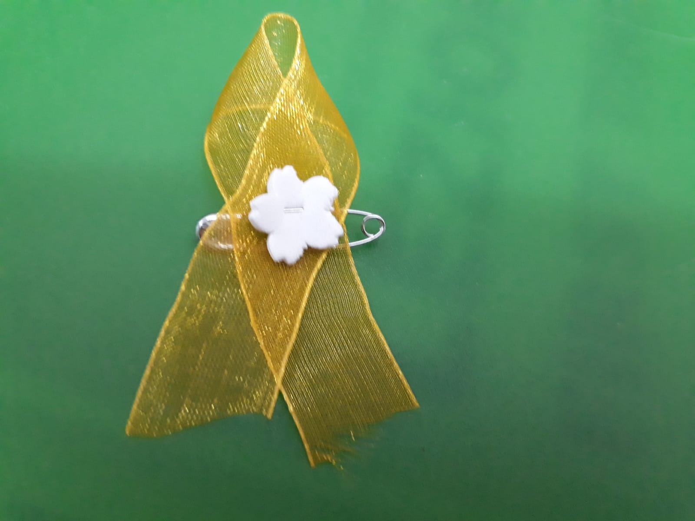
ZAGARA FLOWER
as official symbol
of Task Force
“Child Marriage Prevention”
Notes:
15
15

